Slide 1
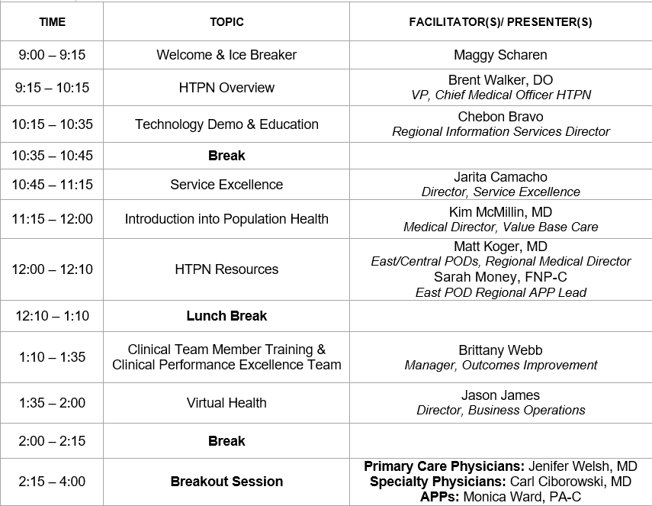
HTPN New Physician & APP Orientation
September 23, 2021 Virtual – Microsoft Teams
OBJECTIVES: Upon completion of this activity, the participant should be able to:
Identify BSWH/HTPN leadership structure and resources within our organization
Recognize what gorals our organization is striving for and how they play a role in the overall success of HTPN
Navigate our intranet site and understand the technology applications our organization uses
Explain and comprehend our population health strategy
*This content is not related to products or business lines of an ACCME–defined commercial interest
**There are no relevant financial relationships with ACCME-defined commercial interests for anyone who was in control of the content of this activity. ACCREDITATION: The A. Webb Roberts Center for Continuing Medical Education of Baylor Scott & White Health is accredited by the Accreditation Council for Continuing Medical Education (ACCME) to provide continuing medical education for physicians.
DESIGNATION: The A. Webb Roberts Center for Continuing Medical Education of Baylor Scott & White Health designates this live activity for a maximum of 5.25 AMA PRA Category 1 Credit™. Physicians should claim only the credit commensurate with the extent of their participation in the activity.
Rev Lect 9/8/20

