Slide 1
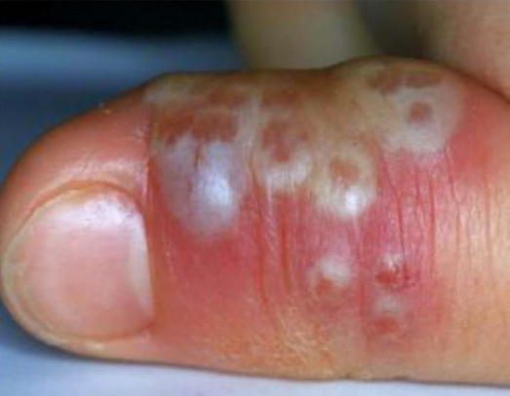
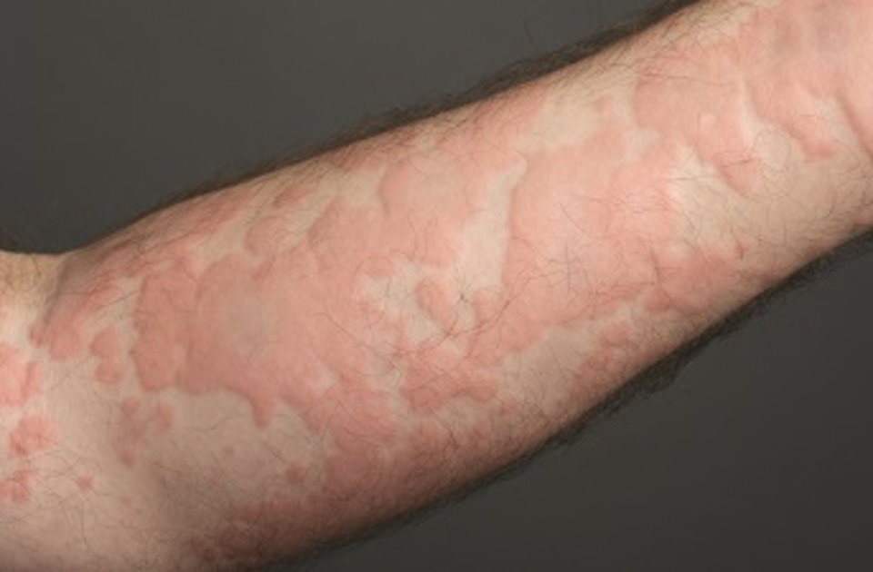
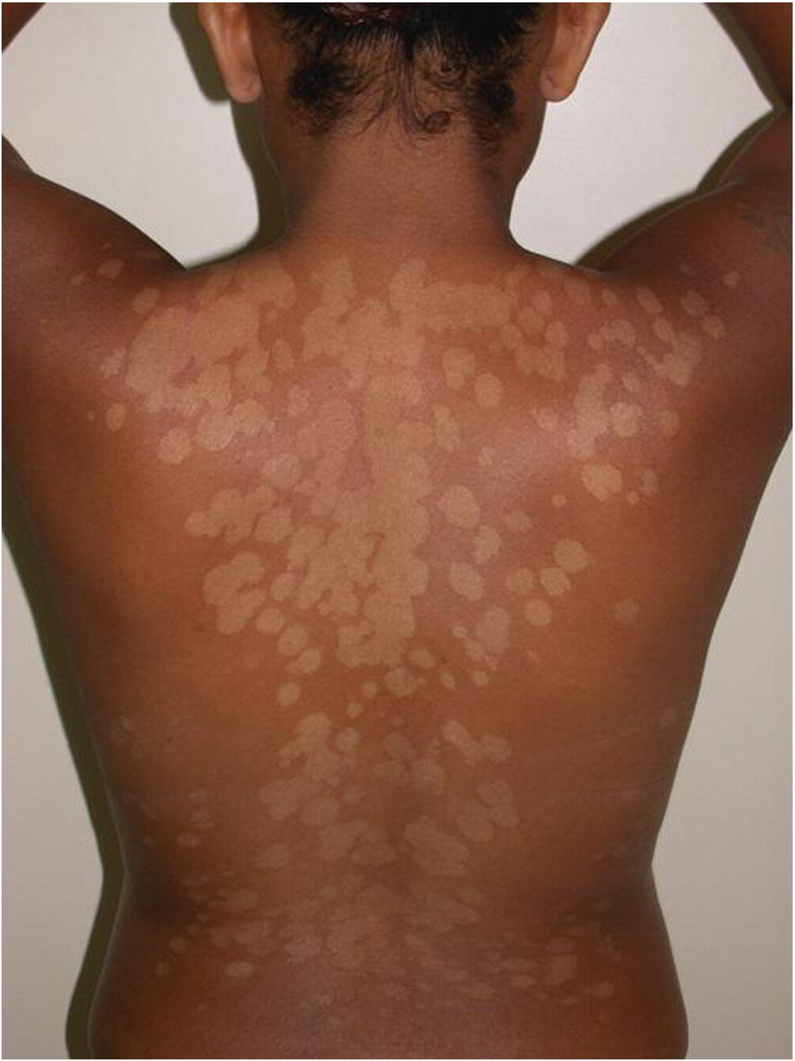
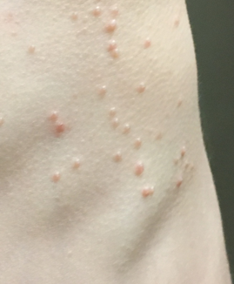
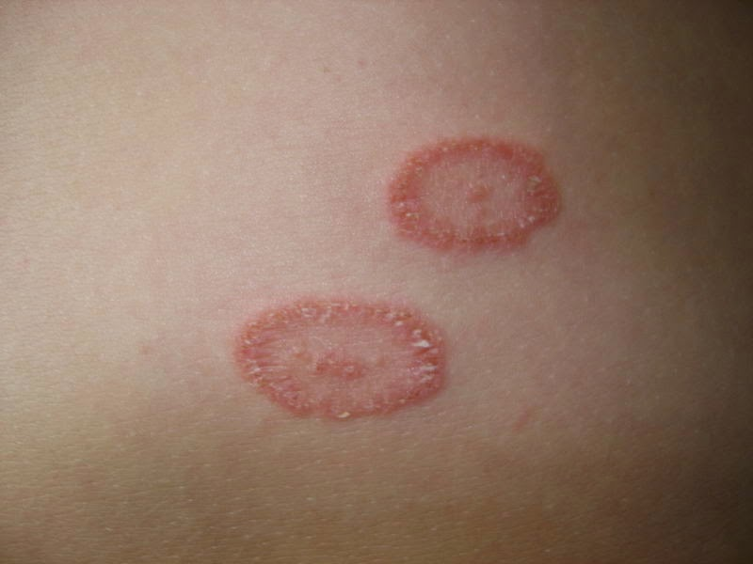
Dermatology Hodgepodge
School nurse version!
By Dr. Jamie Avila, FAAP

Slide 2
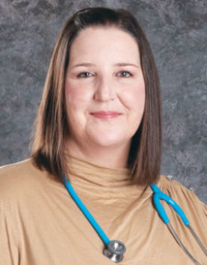
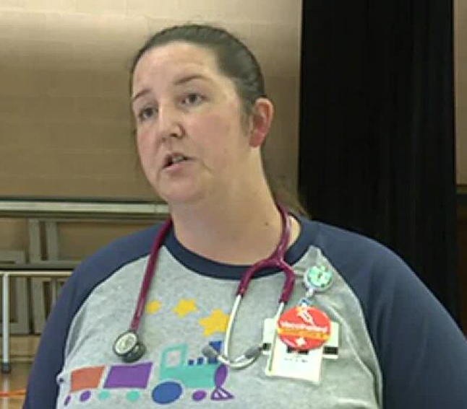
Who Am I:
Division Chief of Outpatient Pediatrics for McLane Children’s Central Region
Clinic Director of McLane Children’s Killeen Clinic
Board Certified Pediatrician

Slide 3
The boring (but important) stuff:
I have no conflicts of interest or financial relationships to disclose.
Objectives for today:
1. Identify and describe common skin conditions that children may present to your clinic with.
2. Discuss the cause, characteristics, and basic first line treatment for common rashes/skin lesions.

Slide 4
Agenda
Non-contagious rashes
Viral rashes
Bacterial rashes
Fungal rashes
Creepy Crawly rashes

Slide 5
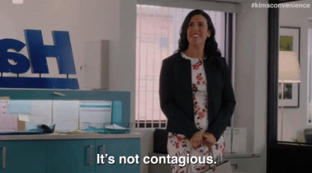
Common Rashes that they can’t share

Slide 6
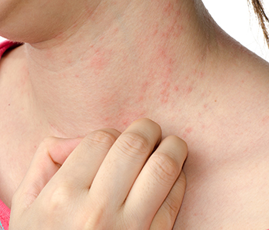
Dermatitis
Aka..I don’t know what you have but it’s probably not a big deal!
Derma = skin, -itis = inflammation
Several specific types of dermatitis
Contact
Seborrheic
Atopic
Typically improve with supportive care and don’t need prescription medication.
Keep skin clean and dry

Slide 7
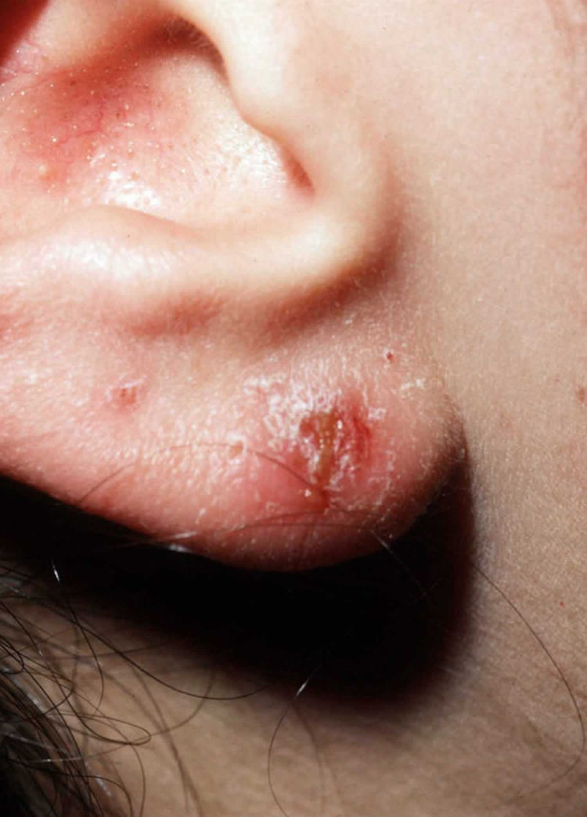
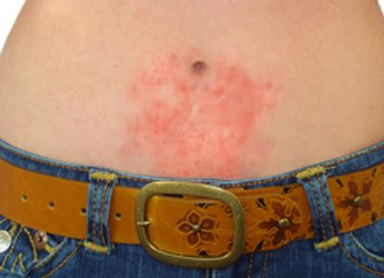
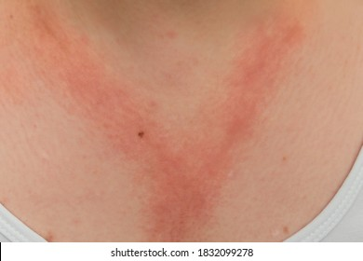
Contact Dermatitis
Rash that develops after contact with allergen or irritant
Perfumes
Dyes
Soaps
Jewelry/Metals
Plant oils
Typically localized to the area that came in contact with offender
Treatment:
ELIMINATE OFFENDER
Don’t scratch!!
Clean area well
Cool compresses
Antihistamines for itching (oral > topical)
Topical steroid creams
In rare, severe cases may need oral steroids
https://lupon.gov.ph/contact-dermatitis-ear-piercing-c-Yom8R4iy
https://nickelsmart.com/nickel-allergy

Slide 8
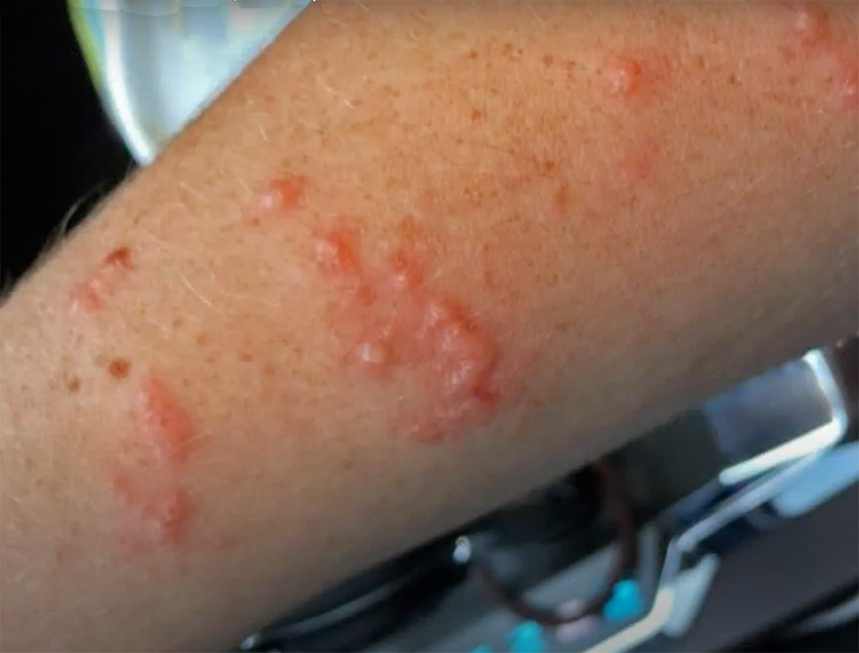
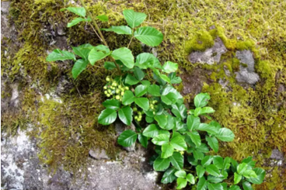
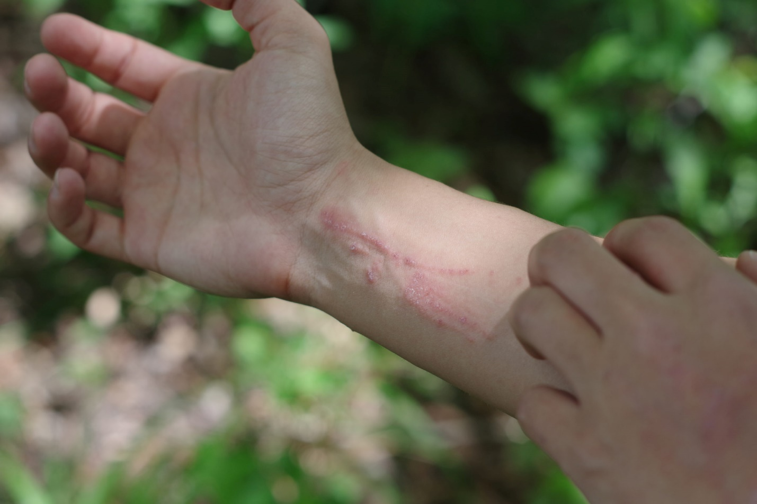
Contact Dermatitis
Poison Ivy
Poison Oak
https://www.verywellfit.com/poison-oak-photo-4020320
https://www.verywellhealth.com/poison-ivy-rhus-dermatitis-1068760

Slide 9
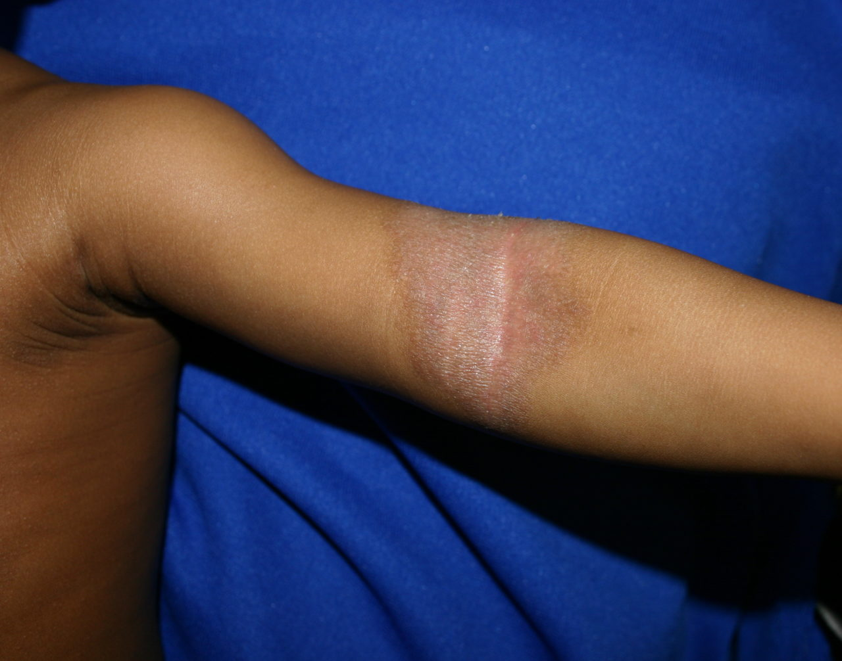
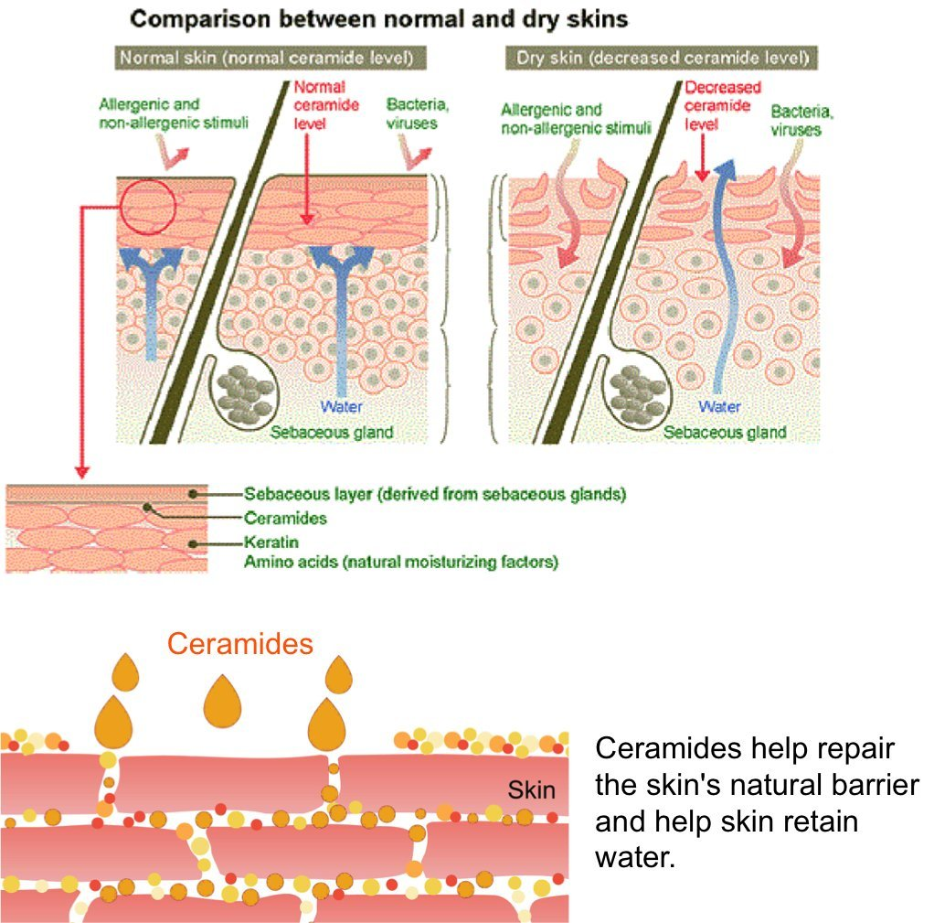
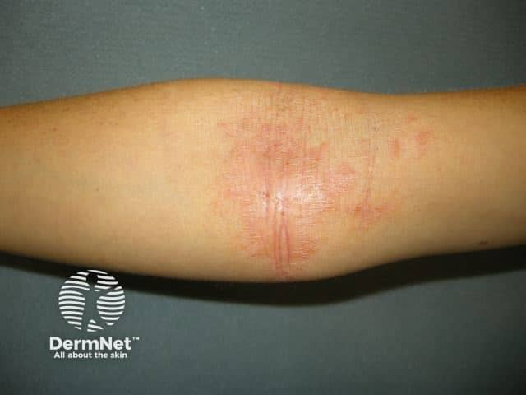
Atopic Dermatitis…aka Common Eczema
What is it?
Inflammatory condition that causes dry, itchy rashes on skin
Who Gets it?
More than 31 MILLION Americans have a form of eczema
What Causes it?
Not so sure…but likely an interaction between genes and environmental triggers
Treatment:
Moisturization
Reduce contact with irritants
Steroid creams
https://www.pulmonologyadvisor.com/home/decision-support-in-medicine/dermatology/atopic-dermatitis-atopic-eczema/
https://eczemahealingguide.com/cerave-moisturizing-cream-for-eczema/

Slide 10
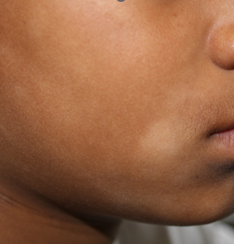
Pityriasis Alba
Dermatitis causing dry, fine-scaled, pale patches on face.
Features:
Typically in ages 3-16 yo
Minimal to no itch
Dryness and scaling more prominent in Winter
Hypopigmentation more noticeable in Summer.
Treatment:
Moisturize
Use Sunscreen
Very mild OTC hydrocortisone if redness or itch
Reassurance and managing expectations (1-3 years to resolution)
https://dermnetnz.org/topics/pityriasis-alba

Slide 11
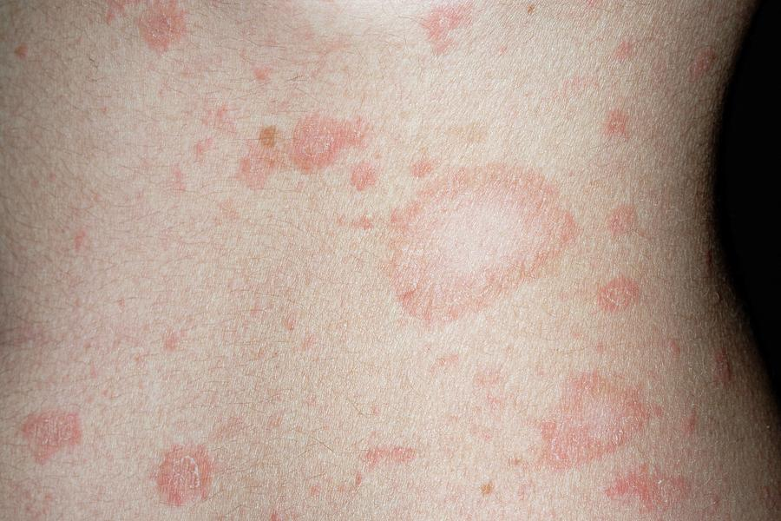
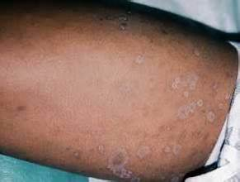
Pityriasis Rosea
Widespread rash on trunk, upper arms and upper legs
Features:
Key feature → Herald patch
“Christmas tree” distribution
Scaling on most lesions
Minimal to no itch
Most common in 10-35 yo
Cause: typically follows a recent viral infection
Treatment:
Moisturize
Short periods of direct sunlight
Oral antihistamines and mild topical steroids if itchy
Reassurance and managing expectations (6-20 weeks for resolution)
https://dermnetnz.org/topics/pityriasis-rosea
https://youmemindbody.com/disease-illness/Strange-rash-Pityriasis-rosea

Slide 12
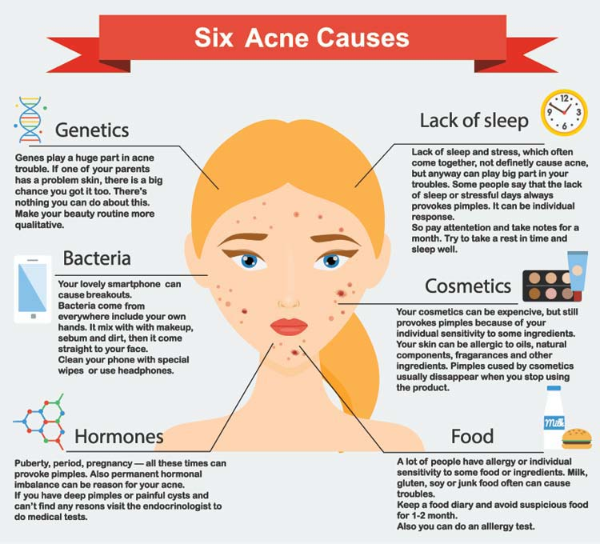
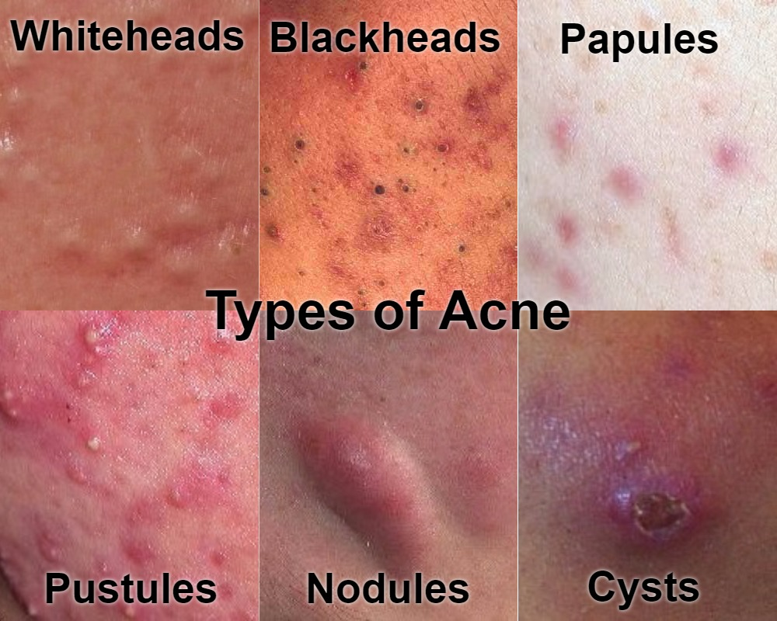
Acne
https://www.ehealthstar.com/conditions/acne-vulgaris/types
https://healthknowledge1.blogspot.com/2017/06/acne-types-symptoms-causes-treatments.html

Slide 13
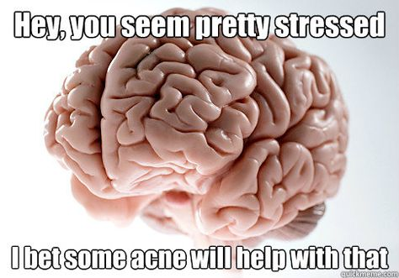

Slide 14
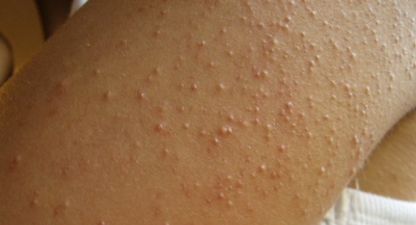
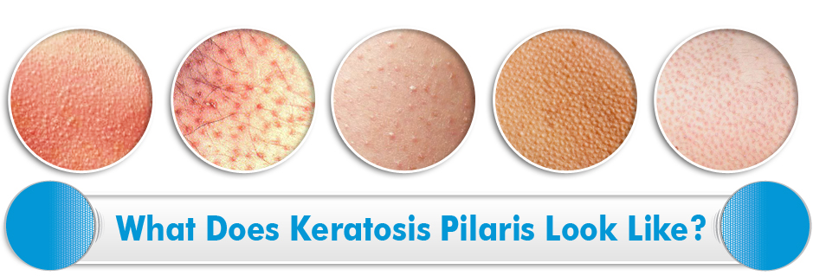
Keratosis Pilaris…aka “Chicken Skin”
THIS IS NOT A RASH!!!
This IS a skin type.
Locations: Arms, thighs, buttocks, face
Occurs at any age
Strong genetic component
Gentle exfoliation followed by moisturization with keratolytic creams (lactic acid, salicylic acid, glycolic acid)
https://kp-essentials.com/what-is-keratosis-pilaris/

Slide 15
Urticaria…aka Hives

Slide 16
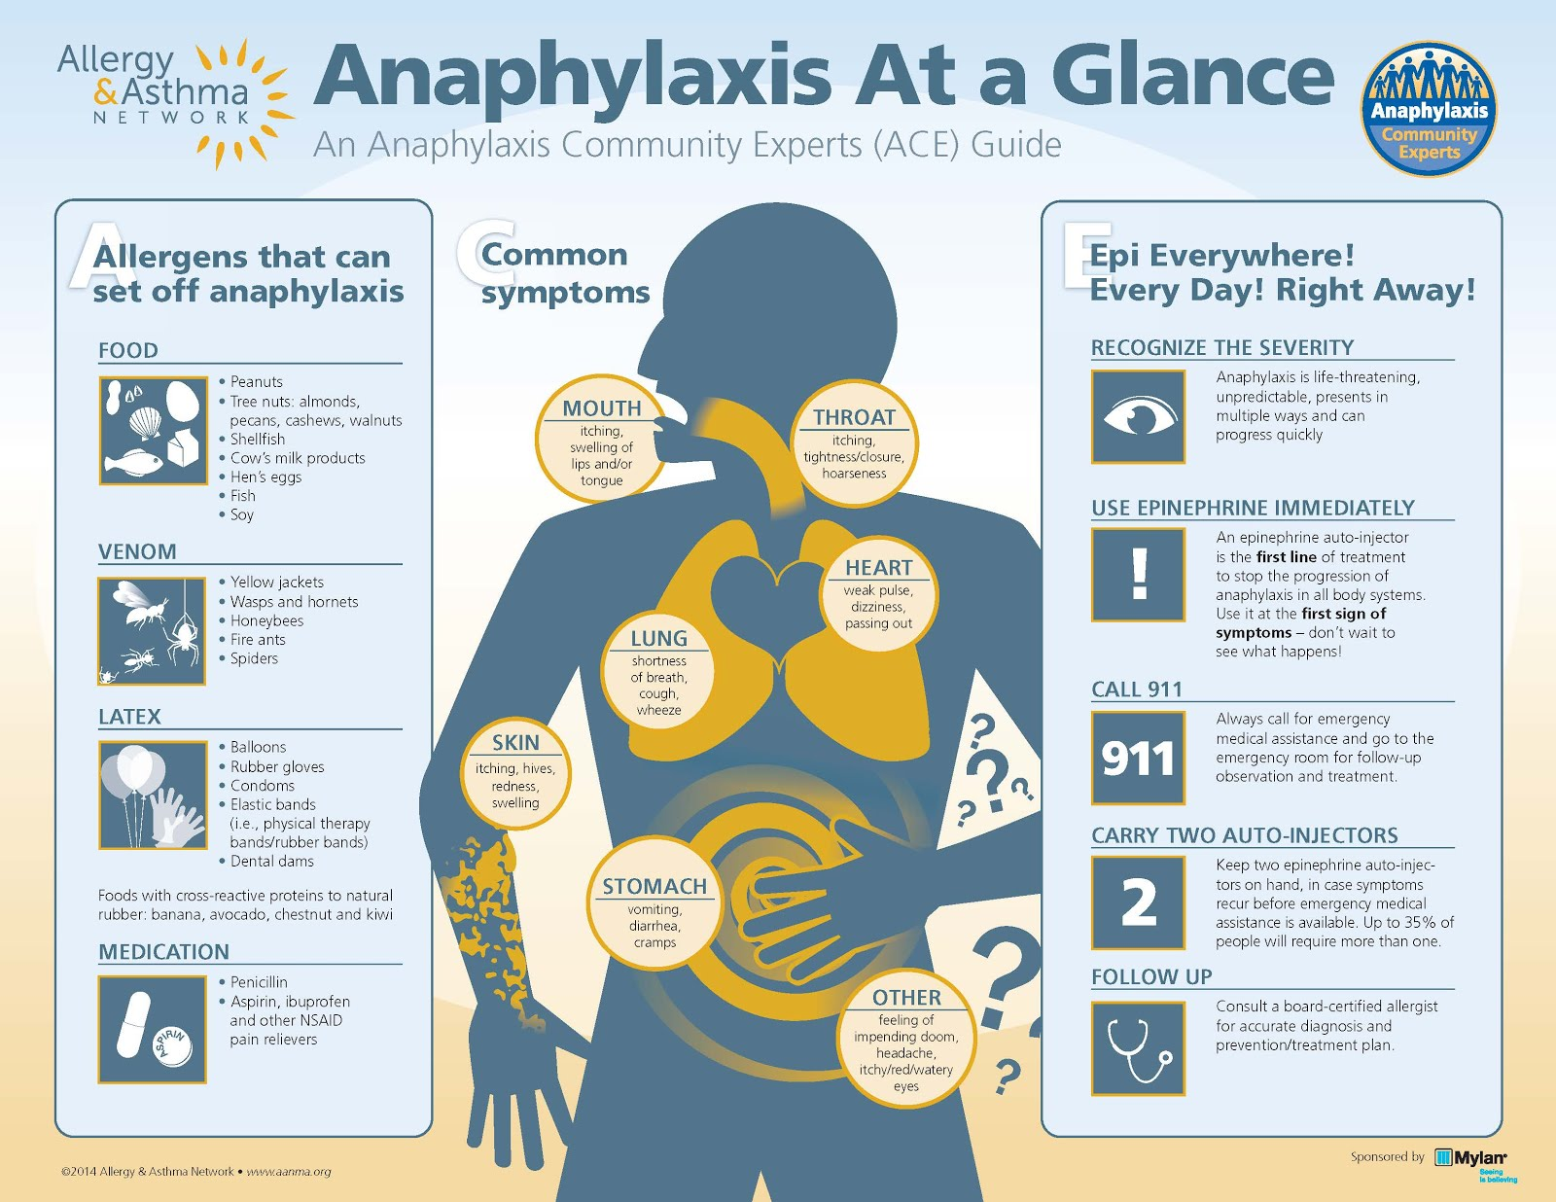

Slide 17
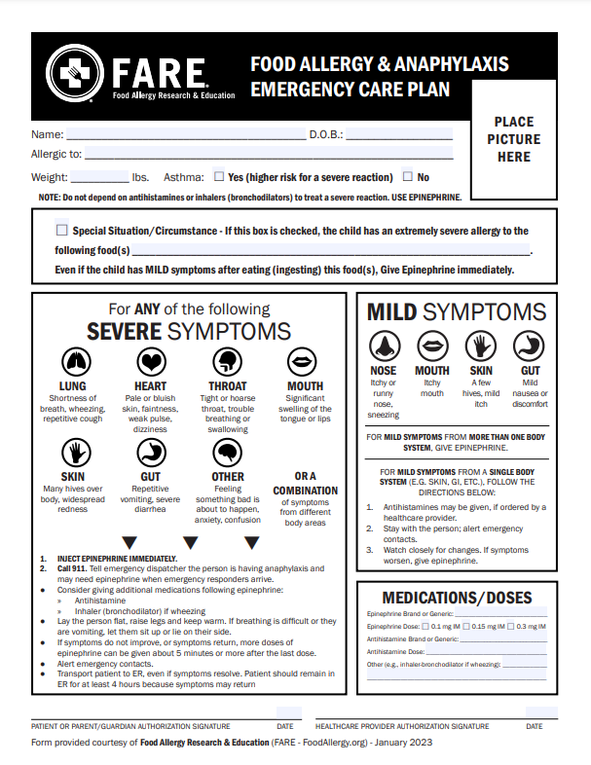
https://www.foodallergy.org/living-food-allergies/food-allergy-essentials/food-allergy-anaphylaxis-emergency-care-plan

Slide 18
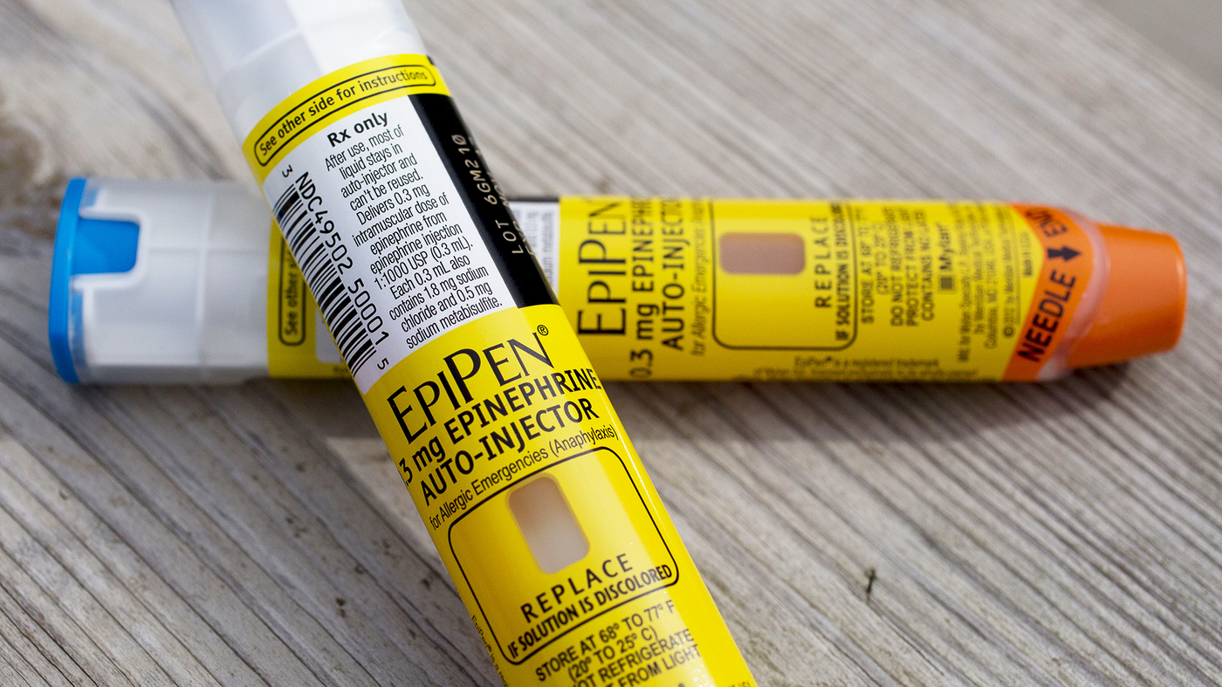

Slide 20
Viral Rashes

Slide 21
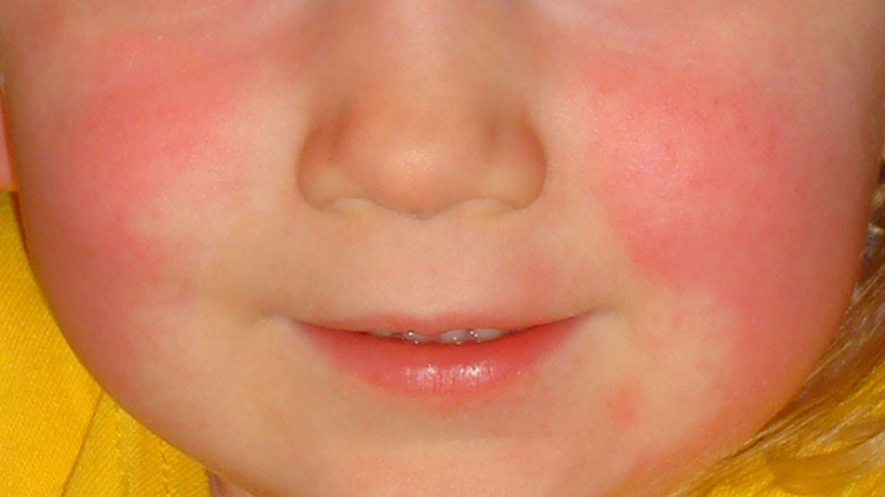
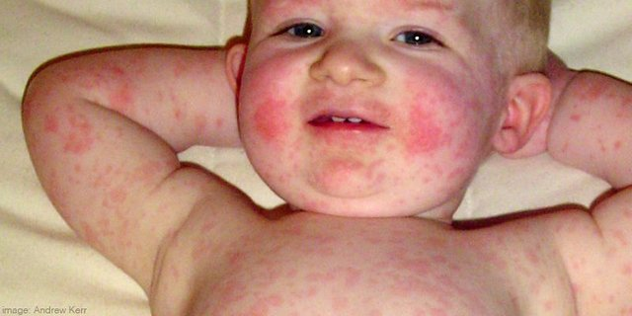
Fifths Disease…Aka “Slapped Cheek Syndrome”
Cause: Parvovirus B19
Symptoms: rash, runny nose, muscle aches, headache, +/- fever.
Incubation period 4-14 days
Spread through Respiratory Droplets
Most contagious BEFORE the rash appears and NOT contagious after rash appears.

Slide 22
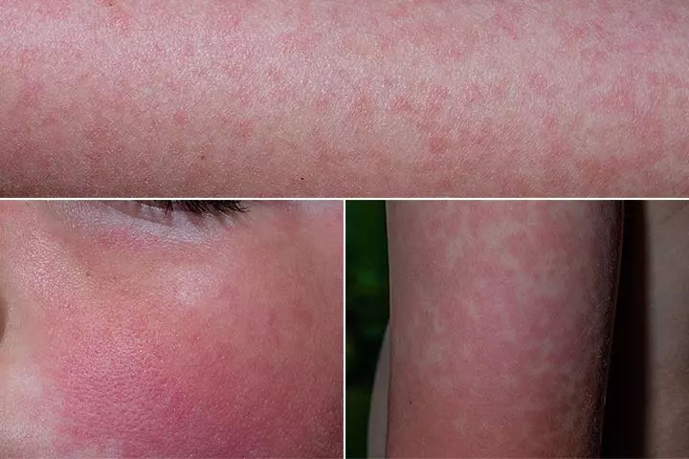
Fifths Disease
Two Phases
1) Slapped cheek appearance that will fade after about 3-4 days.
2) Lacelike reticular rash that appears 1-4 days after facial rash

Slide 23
Fifths Disease
Special Considerations:
Immunocompromised (HIV, Cancer)
Certain types of anemias and Sickle Cell Disease
Pregnant women (highest risk 9-16 weeks)

Slide 24
Varicella…aka Chicken Pox
Incubation period 10-21 days
Very itchy, blister-like rash
Starts centrally (torso and scalp) and spreads outwards
Contagious period – 2 days before rash appears to 1 day after last new blister develops
School return → once all lesions are crusted over.

Slide 25
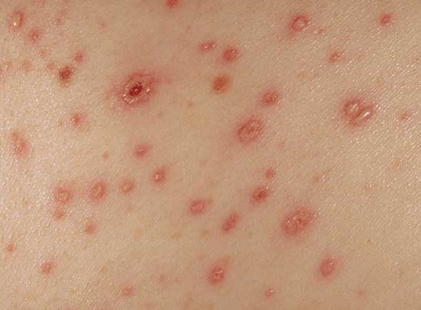
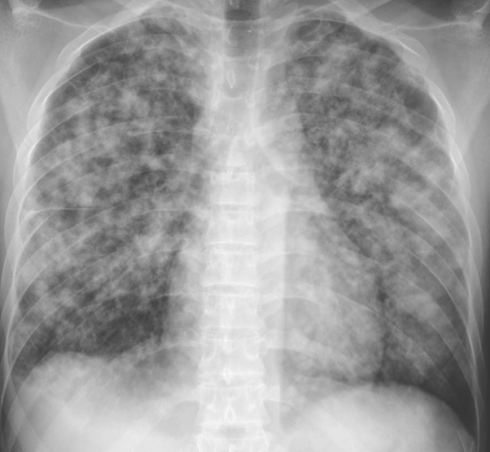
Varicella…aka Chicken Pox
Prevention
Vaccine since 1995
Complications
Pneumonia
Encephalitis
https://step1.medbullets.com/step1-microbiology/104056/varicella-zoster-virus

Slide 26
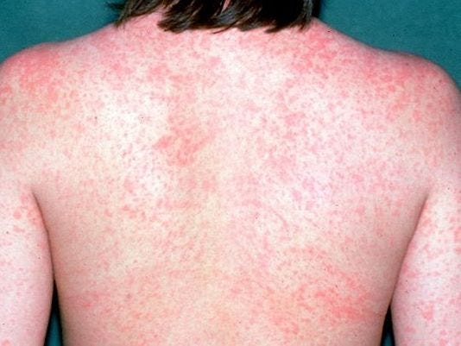
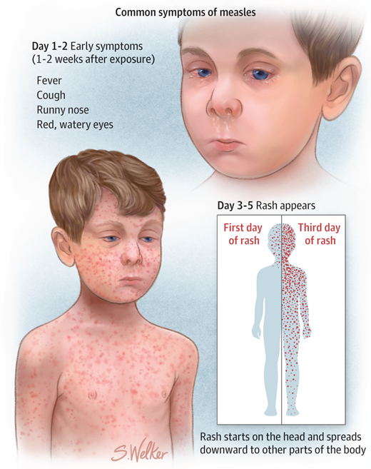
Measles
Cause: Morbillivirus
Symptoms: fever, cough, runny nose, pink eye with copious clear discharge (coryza), rash
Incubation period 10-14 days after exposure
Virus is Airborne and Contact; spread by BREATHING, sneezing, coughing, exchange of body fluids, skin to skin contact, touching contaminated surfaces
Prevention: Vaccination

Slide 27
Measles
EXTREMELY contagious. 9 out of 10 people that are susceptible will get the infection if exposed.
In an outbreak:
Vaccinated children may remain in school
Unimmunized children should be excluded from school until:
Scenario 1 – no know exposure and receives one dose of MMR → immediately
Scenario 2 – known exposure but receives vaccine < 72 hours after exposure → immediately
Scenario 3 – known exposure and receives vaccine > 72 hours after exposure → 21 days after last exposure
Scenario 4 – doesn’t receive a vaccine regardless of exposure → exclude for 21 days after the last case in the school/community.
Complications:
Pneumonia, encephalitis, hearing loss

Slide 28
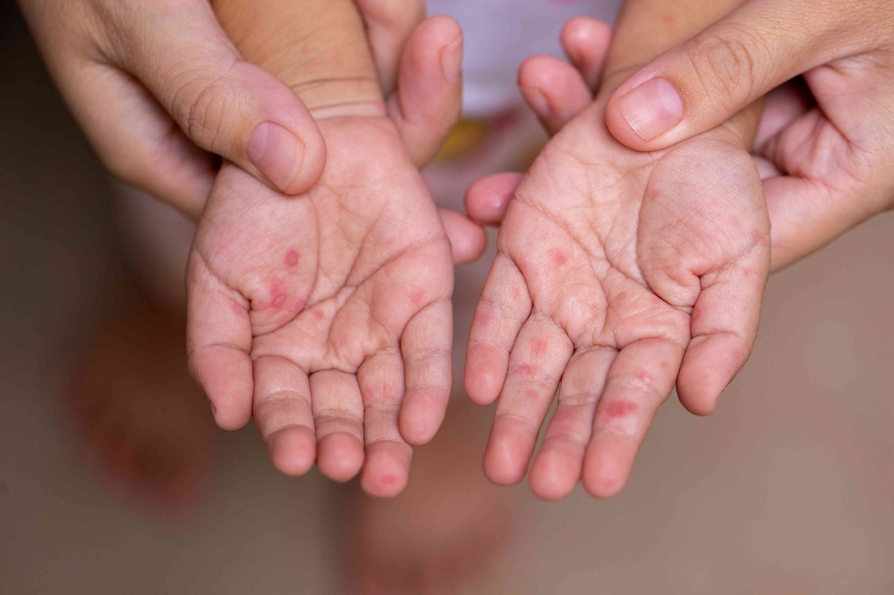
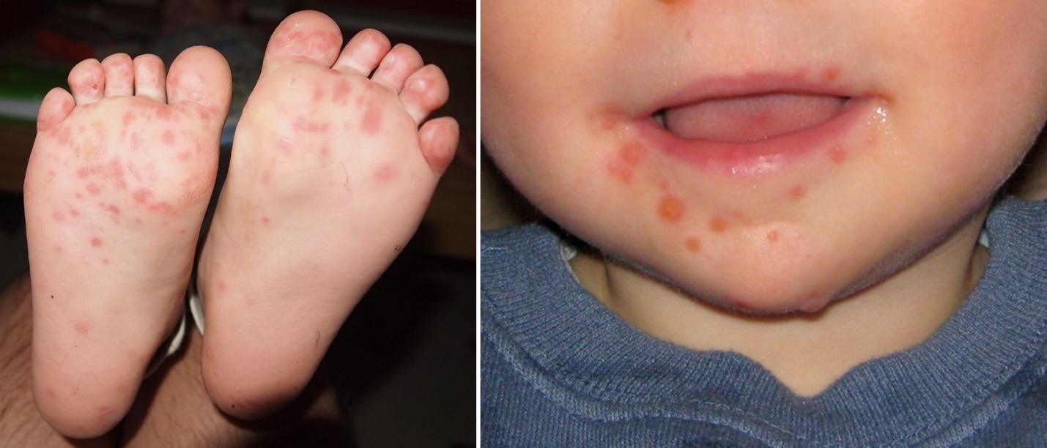
Hand, Foot, and Mouth Disease
Cause: Coxsackievirus
Symptoms: rash, fever, sore throat, runny nose, loss of appetite
Incubation period 3-6 days
Spread through Respiratory Droplets and contact with contagion
Return to school → when fever free for 24 hours. **if widespread blisters may need to stay home until blisters dry up which can be about a week.
https://www.health.com/hand-foot-and-mouth-disease-symptoms-7970011

Slide 29
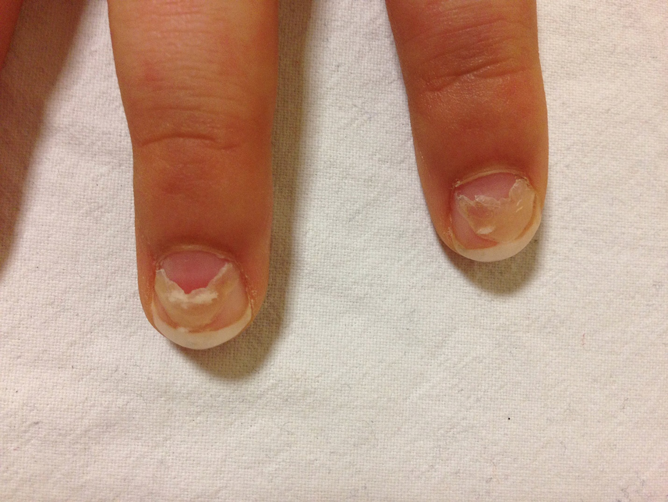
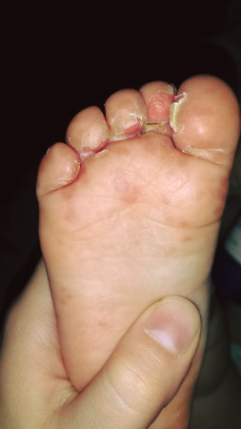
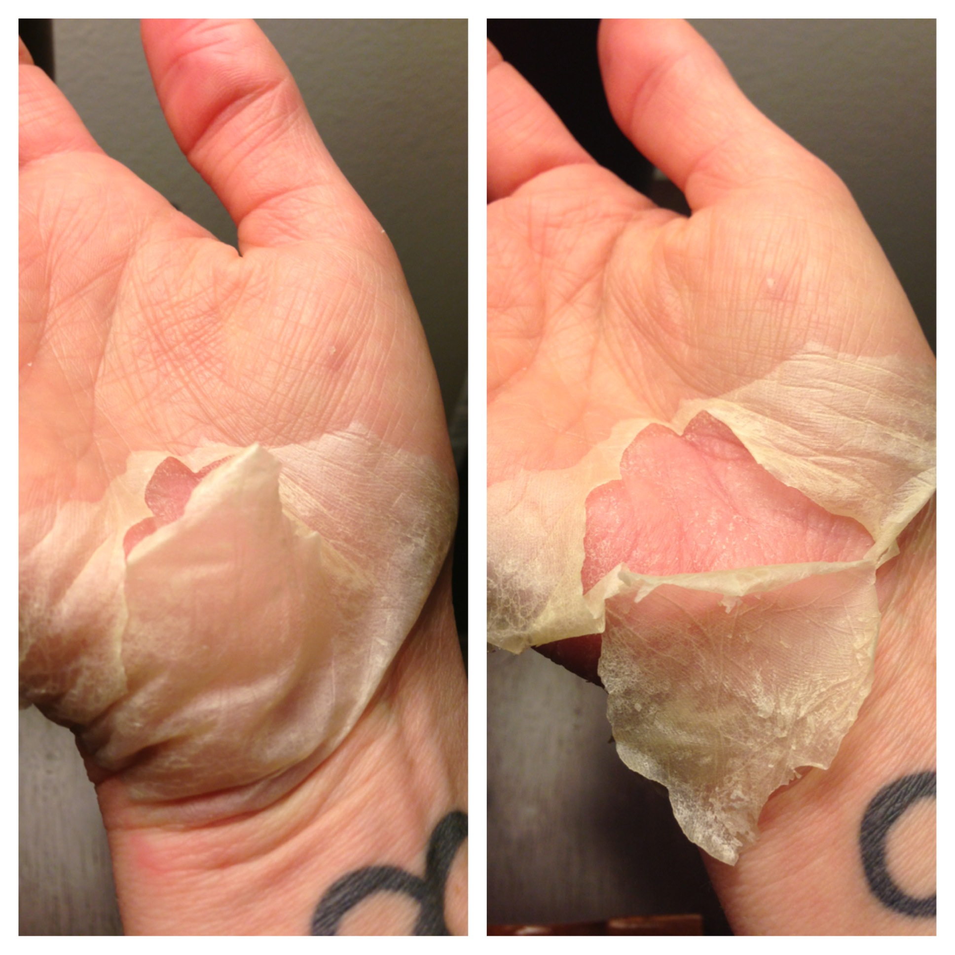
Hand, Foot, and Mouth Disease
Onychomadesis
https://www.health.com/hand-foot-and-mouth-disease-symptoms-7970011

Slide 30
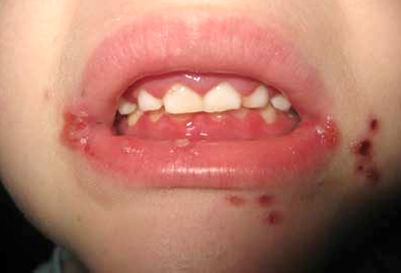
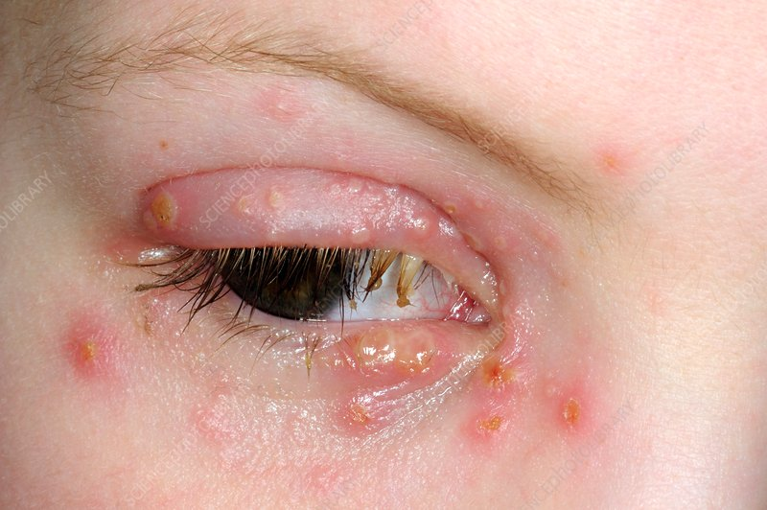
Herpes Simplex Virus…aka HSV
Symptoms: painful blisters on reddened base. Painful ulcerations.
Incubation period 2-12 days from exposure
Symptom duration: days to 2-3 weeks.
Spread: through direct contact with saliva or infected surfaces.
Treatment: NO CURE. Typically supportive care and pain control while lesions resolve. May consider antivirals for significant cases
Return to school: Case dependent.
https://www.rch.org.au/clinicalguide/guideline_index/HSV_Gingivostomatitis/
https://www.sciencephoto.com/media/471492/view/herpes-infection-of-the-eyelid

Slide 31
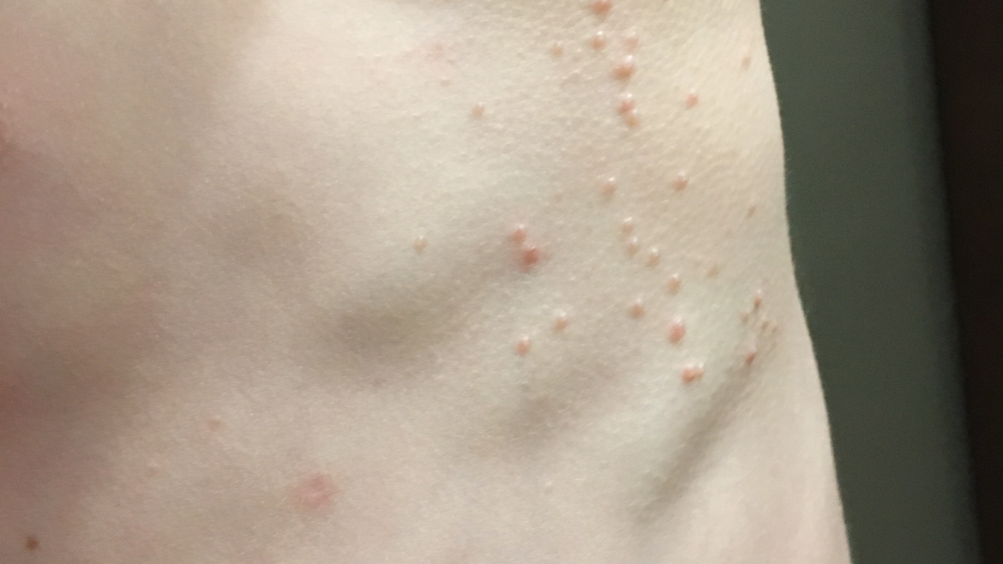
Molluscum Contagiosum
Cause: Poxvirus
Symptoms: umbilicated lesions on skin
Spread through skin to skin contact
Duration: 6-24 months, sometimes longer.
Treatment: reassurance and observation. If necessary cryotherapy, cantharidin.
https://renewdermatology.net/services/molluscum-contagiosum/

Slide 32
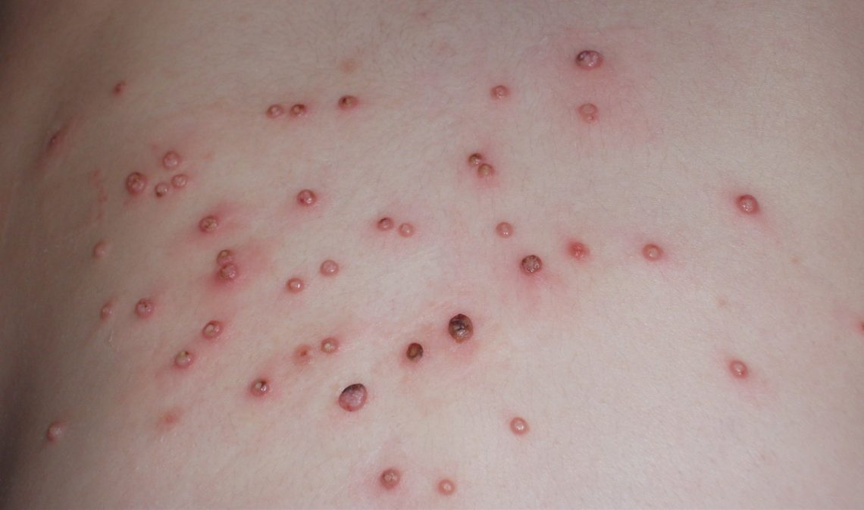
Molluscum Contagiosum
https://renewdermatology.net/services/molluscum-contagiosum/

Slide 33
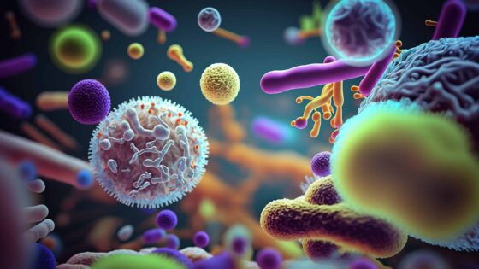
Bacterial Rashes

Slide 34
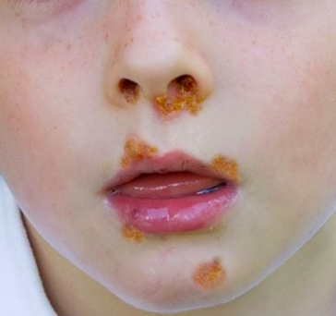
Impetigo
Begin as red papules that rupture and take on a “Honey Crusted” appearance due to oozing from lesions
Causes: Staph aureus or Strep pyogenes
Spread: Through contact
Treatment: topical or oral antibiotics
School consideration: return after at least 24 hours on treatment and ideally until sores crust over

Slide 35
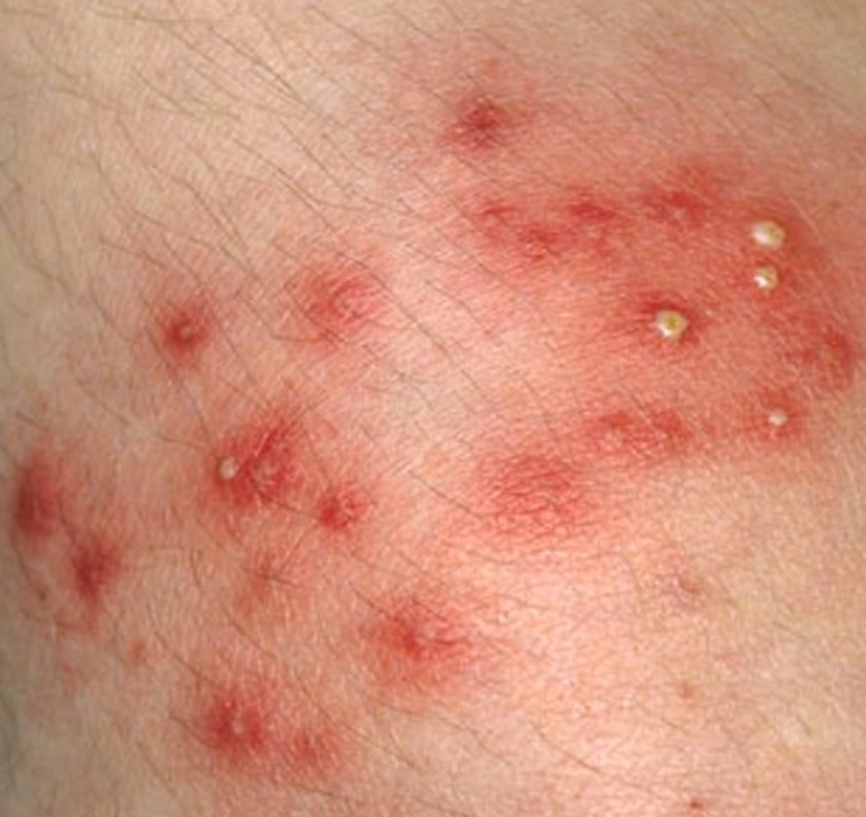
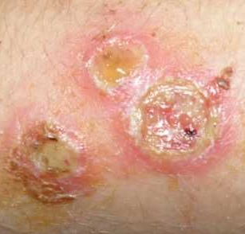
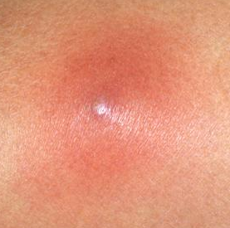
Staph infections
Folliculitis
Impetigo
Boil/Abscess
Cellulitis

Slide 36
Scarlatina
Strawberry Tongue
Strep Pharyngitis

Slide 37
Fungal Rashes

Slide 38
Tinea Infections
Tinea Corporis
Tinea Capitus
Tinea Pedis
Tinea Versicolor
Contagious: Yes
Treatment: Topical Antifungal
Time to resolution: 2-4 weeks
Return: after initiation of treatment
Contagious: Yes
Treatment: Oral Antifungal
Time to resolution: 6-12 weeks
Return: after initiation of treatment
Contagious: Yes
Treatment: Topical Antifungal
Time to resolution: 2-6 weeks
Return: N/A
Contagious: No
Treatment: Topical Selenium Sulfide or Antifungal
Time to resolution: *2 weeks
Return: N/A

Slide 39
Tinea Versicolor Variations

Slide 40
Creepy Crawly Rashes

Slide 41
Warning!!
Itch inducing photos to follow

Slide 42
Bed bugs
Special appearance: clusters of 3, sometimes 5…”breakfast, lunch, dinner”.
Treatment: supportive. Wash with soap and water. Hydrocortisone for itch
Bites are not contagious

Slide 43
Bed bugs

Slide 44
Fleas
Special appearance: diffuse bites on lower extremities with halo of erythema.\
Treatment: supportive. Wash with soap and water. Hydrocortisone for itch
Contagious: No

Slide 45
Fleas

Slide 46
Scabies
Special appearance: bumps, blisters, burrows. Prefer skin folds.
Treatment: Permethrin or Malathion creams
Very contagious – spread through contact
Incubation period: 2-6 weeks

Slide 47
Scabies

Slide 48
Head Lice
Spread by head to head contact or sharing of hair accessories/combs/hats
Treatment: OTC medications, manual removal, prescription medications
School policy for return is up to district

Slide 49
Head Lice

Slide 50
Head Lice
"No healthy child should be excluded from or allowed to miss school time because of head lice. No-nit policies for return to school should be abandoned." (Pediatrics Vol. 126 No. 2 August 1, 2010 pp. 392 -403)

