Slide 1
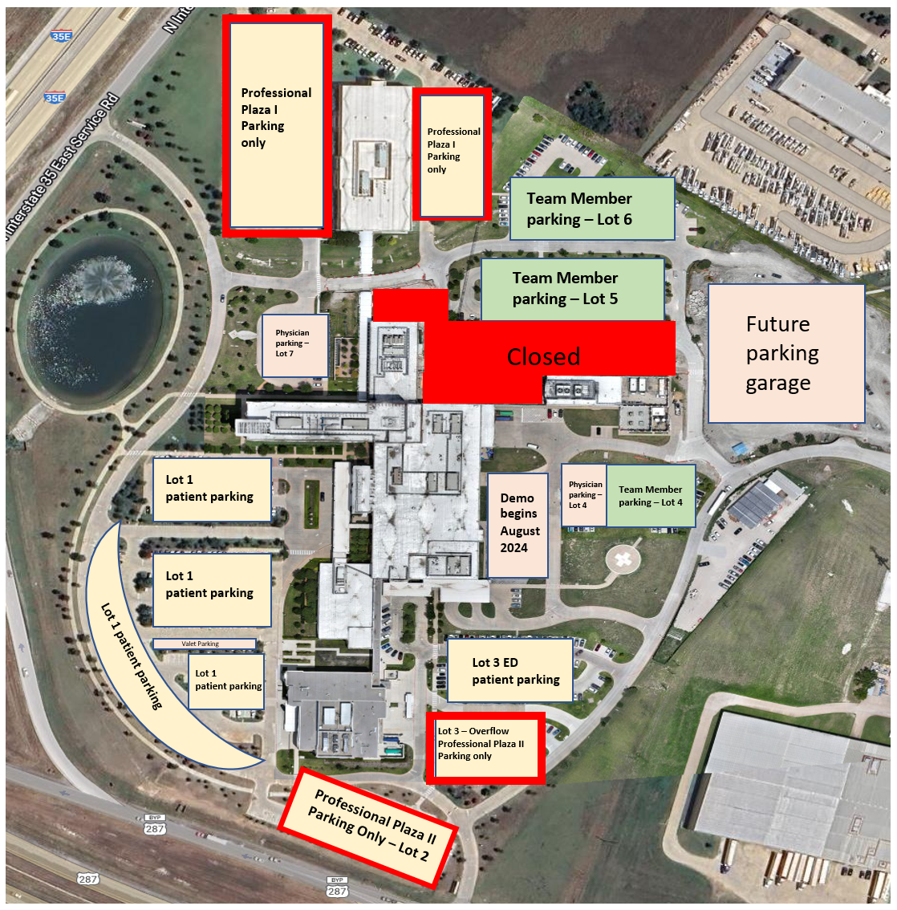
Designated Team Member Parking Areas – August 2024 v2
Lots 5 and 6 are dedicated to Team Member parking
Lot 4 is shared parking with 20 marked Physician spots and the remainder for Team Members
Lots 1, 3 are reserved for patients
Lot 7 is dedicated Physician parking
Lots marked Professional Plaza I and II are reserved for the patients and team members of those buildings respectively
Green Star – Hallway where Workshop will be.
Yellow Arrows - Entrances

