Slide 2
Changing Learner Competence for Beginners - Let's Start With Us
Penny Coots, M.Ed.
Director of CME
Penny.Coots@BSWHealth.org
The A. Webb Roberts Center for Continuing Medical Education of Baylor Scott & White Health
Notes:
I have been in CME for 17 years and prior to that I was a public school teacher and principal for 19 years. So my heart is in education!

Slide 3
Disclosures
The planners and faculty for this course have no relevant financial relationships with any ACCME-defined ineligible companies.
Slides
The slides for this presentation will be uploaded to the ACCME portal after the conference. They will also be available on the BSWH Resource page with link provided near the end of the presentation.

Slide 4
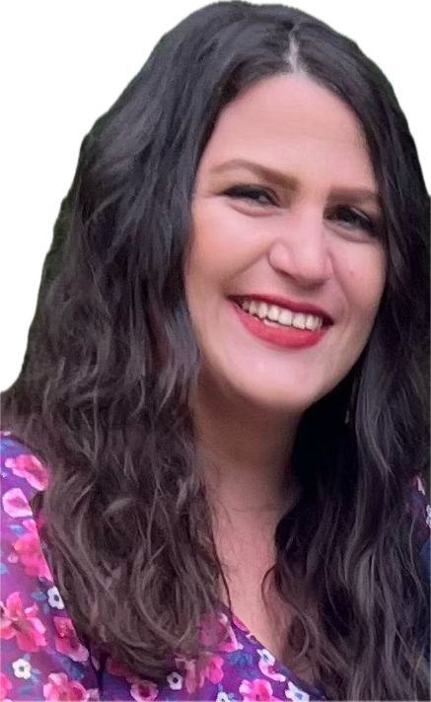
Acknowledgments
Heather Boyd
CME Project Coordinator for the A. Webb Roberts Center for Continuing Medical Education of Baylor Scott & White Health
Brittany Stoughton
Teacher (and my daughter) of 4th grade English Language Arts, Gattis Elementary School, Round Rock, Texas
Notes:
I would like to take a minute to acknowledge Heather Boyd who is on our staff as a Project Coordinator at Baylor Scott & White Health. She put together our demos of the electronic forms you will be seeing later on and created a webpage for you for reference later! I would also like to acknowledge one of my favorite people in the world who is my daughter, Brittany Stoughton. Brittany flew here to be with me today and created the Kahoot game you will be able to play and will answer questions regarding that if you need more information.

Slide 5
Objectives
The learner should be able to
Objective 1:
Utilize the definitions from the AMA/ACCME Glossary of Terms within the realm of accredited continuing medical education to enhance your compliance with ACCME criteria and uphold the Standards for Integrity and Independence in Accredited Continuing Education
Objective 2:
Accurately gather financial information from all individuals overseeing content for an accredited CME activity.
Notes:
While objectives are not required by the ACCME, it is a good practice to create objectives so that you can more easily measure outcomes related to your educational activity later!

Slide 6
Objective 1
Utilize the definitions from the AMA/ACCME Glossary of Terms within the realm of accredited continuing medical education to enhance your compliance with ACCME criteria and uphold the Standards for Integrity and Independence in Accredited Continuing Education

Slide 7
KAHOOT!
Notes:
Now, this activity was designed with the beginner CME provider in mind. Let’s get a quick look at who in here is a beginner! Likely two years or less.

Slide 8
Vocabulary
Every profession has a vocabulary of words that have meaning to the users.
Notes:
Every profession has its own vocabulary and being able to use that vocabulary correctly with your colleagues is extremely important. Not to mention your accreditor will expect you to know the terms and interpret their criteria, standards, and policies as well.

Slide 9
ACCME/AMA Glossary of Terms and Definitions
COMPETENCE
In the context of evaluating the effectiveness of a CME activity in the ACCME System, the extent to which learners know how to implement (or stop doing) what the activity intended to teach them.
ACCME/AMA Glossary of Terms and Definitions | ACCME
https://accme.org/publications/accmeama-glossary-terms-and-definitions

Slide 10
Competence
What does this mean to you?
Notes:
Would be a great place to have a word cloud

Slide 11
Objective 2
Accurately gather financial information from all individuals overseeing content for an accredited CME activity.

Slide 12
Tools for Identifying, Mitigating, and Disclosing
Tools for Identifying, Mitigating, and Disclosing Relevant Financial Relationships | ACCME
Navigate to the Tools located on the ACCME website (click link above). Then download the tools you need!
**(Also, look on the back cover of your conference workbook for QR codes!)
Notes:
Our organization combined the tools for Identifying, Mitigating, and disclosing Relevant Financial Relationships with the Tools to Ensure that Clinical Content is Valid in one electronic form.

Slide 13
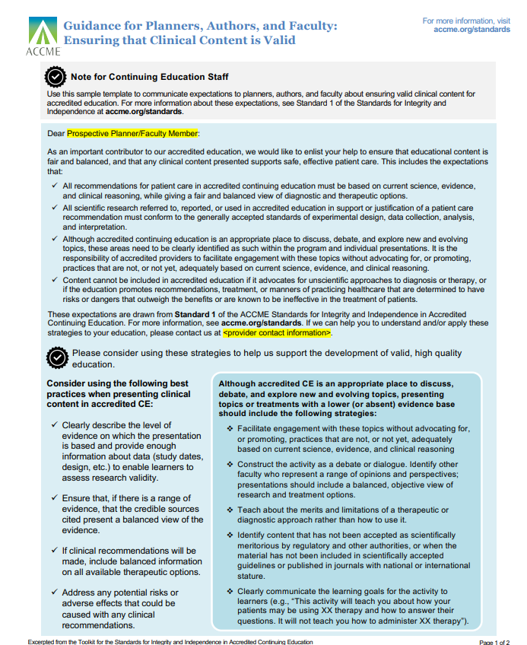
ACCME Tools from the Standards Toolkit
ACCME form:
ACCME form:
Notes:
This is just to give you an idea of what the form looks like in its original format when you download it. We currently only use page 1 of the Guidance form, though there are two pages.

Slide 14
Using the Right Tool for Gathering Information
Recently, our organization adapted the paper form to an electronic version without our learning management system (LMS). This has saved time for us as well as those who are completing the form.
In our learning management system, we do not have to ask the name of the person completing the document or the date because the person “logs in” and their profile information is attached to their submission.
For our purposes today, we created two demonstrations created in Survey Monkey (there is other software)
One with no financial relationships to disclose
One with many financial relationships to disclose.
Notes:
Use this tool for all who are in control of content.
What you will do with the information you receive may be different depending on the role of the person who completed the tool.

Slide 15
Demonstration
Electronic Disclosure form plus content validation attestation – the person who completes it does not have any financial relationships
Electronic Disclosure form plus content validation attestation – the person who completes it has multiple financial relationships
Notes:
Need the links

Slide 16
Change or no change?
.

Slide 17
Outcomes: Assessing a Change in Competence
Educational outcomes may include a change in competence for the learners.
ONE way to assess a change in competence is to ask post activity the following question: “After attending this accredited educational activity, what will you change in practice?”
Remember our definition - Per the ACCME and AMA Glossary of Terms and Definitions, Competence is defined in the context of evaluating the effectiveness of a CME activity in the ACCME System, as being the extent to which learners know how to implement (or stop doing) what the activity intended to teach them.

Slide 18
Will You Be Changing Anything In Your Practice?
Step 1
Objectives are developed in terms of what the learner should be able to do differently after attending accredited education.
Accredited education should provide a strategy (or strategies) for improvement.
Step 2
Provide a post-activity evaluation containing the open-ended question, “After attending this accredited activity, what will you change in practice?”
Step 3
Examine the data and sort it by relevance to the objectives of the activity.
Determine if the percentage of those indicating a change should be deemed acceptable or if further education may be indicated.
Look at the percentage of those who indicated at least one change that aligns with your objectives.

Slide 19
Will You Be Changing Anything In Your Practice?
Step 1
Create a document that includes all of the necessary components to accurately gather financial relationship information from all in control of content – this can be paper or electronic
Step 2
Ensure that all planners complete the document before planning AND that all faculty complete the document before the beginning of the activity with enough time allowed for mitigation if needed
Step 3
Mitigate relevant financial relationships for planners before proceeding with planning AND for faculty before the beginning of the activity
Ensure that the provider (you) determines if any financial relationships are relevant
Disclose relevant financial relationships of planner and faculty to the audience before the beginning of the activity, even if it is to say that “There are no relevant financial relationships.”
If mitigation is needed, then include the statement that “All relevant financial relationships have been mitigated.” in your disclosure to the audience.

Slide 20
Did We Change Our Own Competence?
Competence In the context of evaluating the effectiveness of this Teach and Inspire activity, What will you change in your practice?
Possibilities:
State that you will add the open-ended question, “After attending this activity what will you change in practice?” to your post-activity evaluations.
State that you will incorporate the ACCME forms (including their definitions) into your process for collecting financial relationships from all in control of content for an accredited activity.

Slide 21
BSWH Resources
https://ce.bswhealth.com/Learn2Thrive-beginner-competence
Notes:
The slides for this presentation as well as other resources will be published on the webpage associated with the link above.

Slide 22
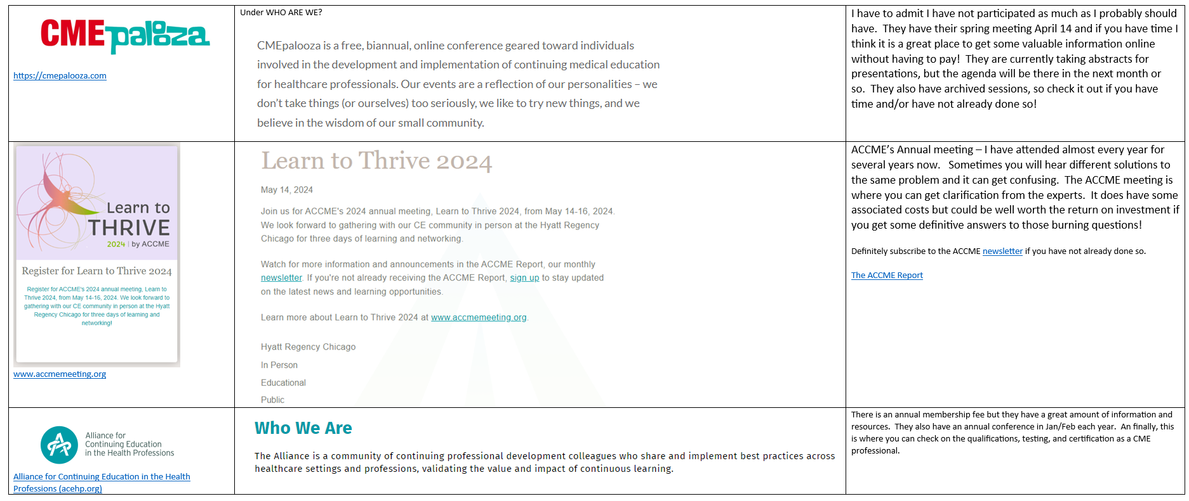
Resources

Slide 23
THANK YOU!

