Slide 1
EthosCE On-Going issues
Prioritized from highest priority to least

Slide 2
EthosCE Meetings
How are we going to manage our on-going EthosCE meetings?
CME met with Dave every Tuesday at 11am CST.
Missed meetings with CME:
08/06/2024
11/19/2024
Community Health LG signed an agreement for 3 hours of EthosCE assistance.
They are urgently working towards launch of their educational offerings with known deadline to be November
Missed meeting with LG:
11/15/2024

Slide 3
Community Health Learning Group Questions/update

Slide 4
Community Health Learning Group Questions/update - Summary
Breadcrumb – Desire to hide the “home” button on LG pages
Logo Link Question
Course Max Enrollments
Location Tags - RESOLVED

Slide 5
Community Health Learning group
Breadcrumb – Desire to hide the “home” button
https://ce.bswhealth.com/community-education/events
If we “hide” this breadcrumb, would this be the only breadcrumb in this learning group hidden? Or would it also hide all breadcrumbs that follow it?
Will it only affect this LG?

Slide 6
Logo Link Question
Community Health Learning Group
LG wants the logo to take the user back to the Community Education page rather than our Ethos home page.
Currently, it’s unlinked, they would like to link it back to the learning group home page. https://ce.bswhealth.com/community-education/events

Slide 7
Course Max Enrollments
Community Health Learning Group
When viewing from a catalog standpoint - if a course within an LG has maxed enrollment and no waitlist, why does it still show or not provide some sort of identifier that it is “full”(Cheryl)

Slide 8
Location Tags
Community Health Learning Group
We see the location tag was added to the custom field
We added all the locations we will use
We added two locations to a current back pain seminar we have built however the location field is not showing under Courses on our main page
RESOLVED

Slide 9
CME

Slide 10
CME - New Project

Slide 11
New Project - RSS
Description: There is a desire to “share” some of our grand rounds with Baylor College of Medicine. Because we are a not-for-profit hospital system, sharing CME activities that are not in the scope of work for employees affiliates falls into a gray area under the Starke Law. For this reason, we have to charge the participants individually, at minimum, the FMV for a CME activity.
RSS credit claim can be limited to BSW members only. However, there are affiliates that have been allowed to claim credit under special circumstances and so we have not limited the enrollment of some activities for participants to only those with SSO (BSW members).
We use the “TEXT IN” feature for attendance in most of these activities.
We do not currently charge individual participant fees.
Is there a way to set up a fee for only certain individuals/groups?
Parent/child
Subscription
Attributes
Other ideas?

Slide 12
CME - PARs Report Issues

Slide 13
Failed Credit Report
10.08.2024 Ticket # ECE-6889, forward to Dave
Part 1: Multiple activities were having reporting issues. After talking with Dave and forwarding the ticket several of the issues disappeared.
Part 2: However, we have two activities (see below) that have an “Error 672 – Activity completion date precedes activity start date.” We have reviewed this multiple times and are unable to determine why it will not report to the board. Dave asked us not to do anything yet. We would like to get these submitted before the end of the year.

Slide 14
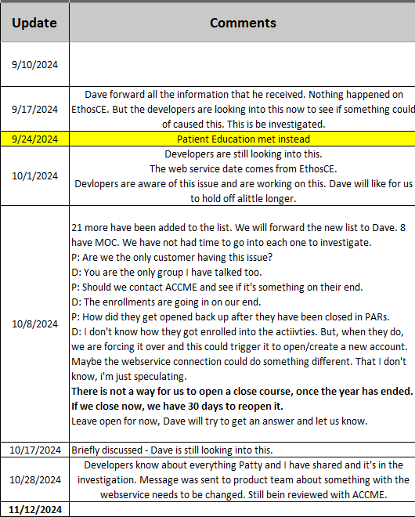
PARs Error message – Duplicating activities in ACCME
09.10.2024 – 2021-2023 shows there was an update on 08/30/24 and 09/03/24 – In PARs it looks like it was duplicated. (Report was emailed to Dave)
09.17.2024 – Dave forwarded all the information that he received to the developers. According to Dave, the developers are looking into this now (10.28.2024) to see if something could have caused this. - Dave stated that it might be something with web services.
PARs Error Message - Duplicating activities in ACCME | Baylor Scott and White Health CE
PARS Report shown below:

Slide 15
BSWH Brooke’s Team API Connector

Slide 16
API Team
API Team requesting meeting 11/13/2024

Slide 17
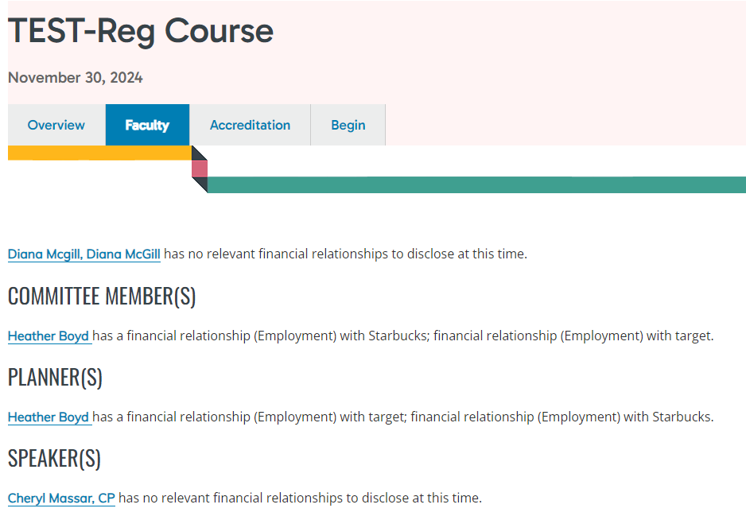
API Team
Faculty Area in EthosCE
If we use the Faculty option - is there a transcript area within the user profile that maybe we have turned off?
Is there a way to hide the text, after the name we selected?

Slide 18
API TEAM
Exhibitor Component
Is there an exhibitor component within ethos?

Slide 19
CME Issues

Slide 20
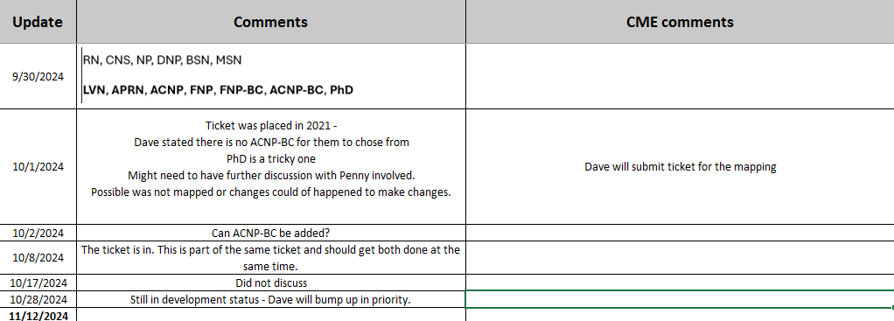
CME Problem
ANCC Credit Mapping
Bold letters are what we are requesting

Slide 21
CME Problem
Pending RSS Activities
CORE TICKET – 06/08/2023 turned in by Dave
Sessions are old (dating back a year or longer) still showing on the pending activities and users are able to claim credit, even though the series is closed.
Could this be why it duplicated in PARs?

Slide 22
CME Question
Core Tickets and Developer Status
We have several items that have turned into Core Tickets or Developer status, how can we receive an updated status on these?

Slide 23
CME Question
CME Passport and CEBroker
If we decide to use CME Passport, how does the data get inputted into EthosCE?
We have to also have a question asking if it’s okay to report the user data
If a user declines the permission to not report data automatically, would we be able to report AMA without reporting the MOC.
Can EthosCE report to both or one vs the other?

