Slide 1
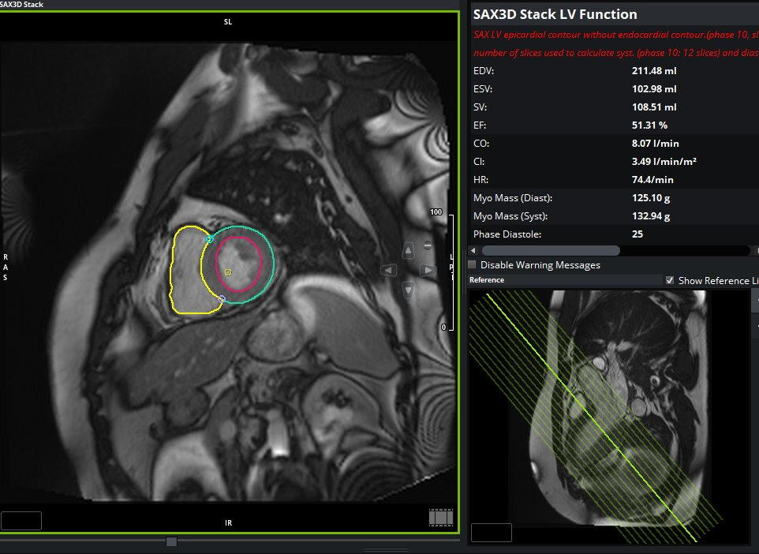
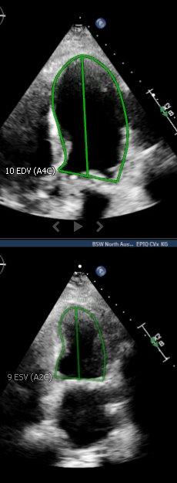
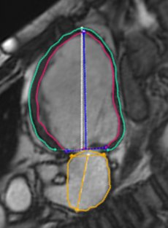
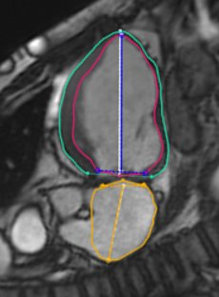
Artificial Intelligence and Expert Reader MRI Biplane vs Echocardiographic Biplane Measurements
Avery Carter, MD; Jerry Fan, MD; Kadilee Adams, DO; Patrick McGrade, MD; Vinh Nguyen, MD; Ossama Abou Hassan, MD
Introduction:
Assessment of LV ejection fraction and LV volume by echocardiogram has been the gold standard, particularly by Simpson’s Bi-plane method. However, with the use of AI, we have been able to identify technical difficulties in echocardiographic LV volume and EF estimation. MRI assessment of LV volume has always been larger than echocardiographic Bi-plane estimation. In this study, we are comparing the AI Bi-plane method generated by MRI to the gold standard, reader generated volumes (EDV, ESV). We will also compare echocardiographic Bi-plane volumes (EDV, ESV) that is confirmed by experienced echocardiographers to the gold standard short axis contouring by MRI.
Methods:
This was an observational study with retrospective chart review of 20 patients who obtained MRI and concomitant echocardiogram within 6 months of each exam. AI Bi-plane generated MRI volumes were compared to the gold standard of that obtained by traditional echocardiography. Additionally, the gold standard of MRI quantification (short axis contouring) was compared to echocardiographic Bi-plane volumes by experienced readers.
Conclusion:
The use of AI in cardiac MRI can be effectively used to overcome technical difficulties encountered in echocardiographic assessment of LV volume and ejection fraction estimation due to foreshortening.
Results:
The average EDV and ESV by AI generated bi-plane MR were 227 and 121, respectively. By bi-plane echocardiography, average EDV and ESV were 144 and 70, respectively. By AI generated short axis MRI contouring and gold standard reading, EDV and ESV were 224 and 125, respectively. AI bi-plane generated assessment of EDV and ESV were larger than those obtained by echocardiographic assessment (p<0.05 ). Additionally, gold standard reader-dependent MRI assessment of EDV and ESV were larger than those obtained by gold standard reader-dependent echocardiographic assessment (p<0.05).
References:
Chuang, M, Hibberd, M, Salton, C. et al. Importance of imaging method over imaging modality in noninvasive determination of left ventricular volumes and ejection fraction: Assessment by two- and three-dimensional echocardiography and magnetic resonance imaging. JACC. 2000
Thomas A Foley, Sunil V Mankad, Nandan S Anavekar, Crystal R Bonnichsen, Michael F Morris, Todd D Miller, Philip A Araoz, Measuring Left Ventricular Ejection Fraction - Techniques and Potential Pitfalls, European Cardiology 2012 Herregods MC, De Paep G, Bijnens B, et al. Determination of left ventricular volume by two-dimensional echocardiography: comparison with magnetic resonance imaging. Eur Heart J. 1994
Foreshortening on 2D echo affects volume measurements and ejection fraction assessment

