Slide 1
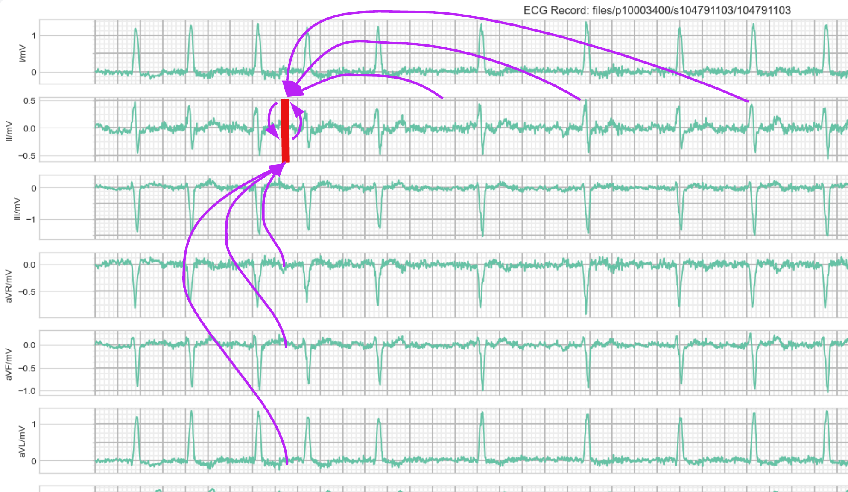
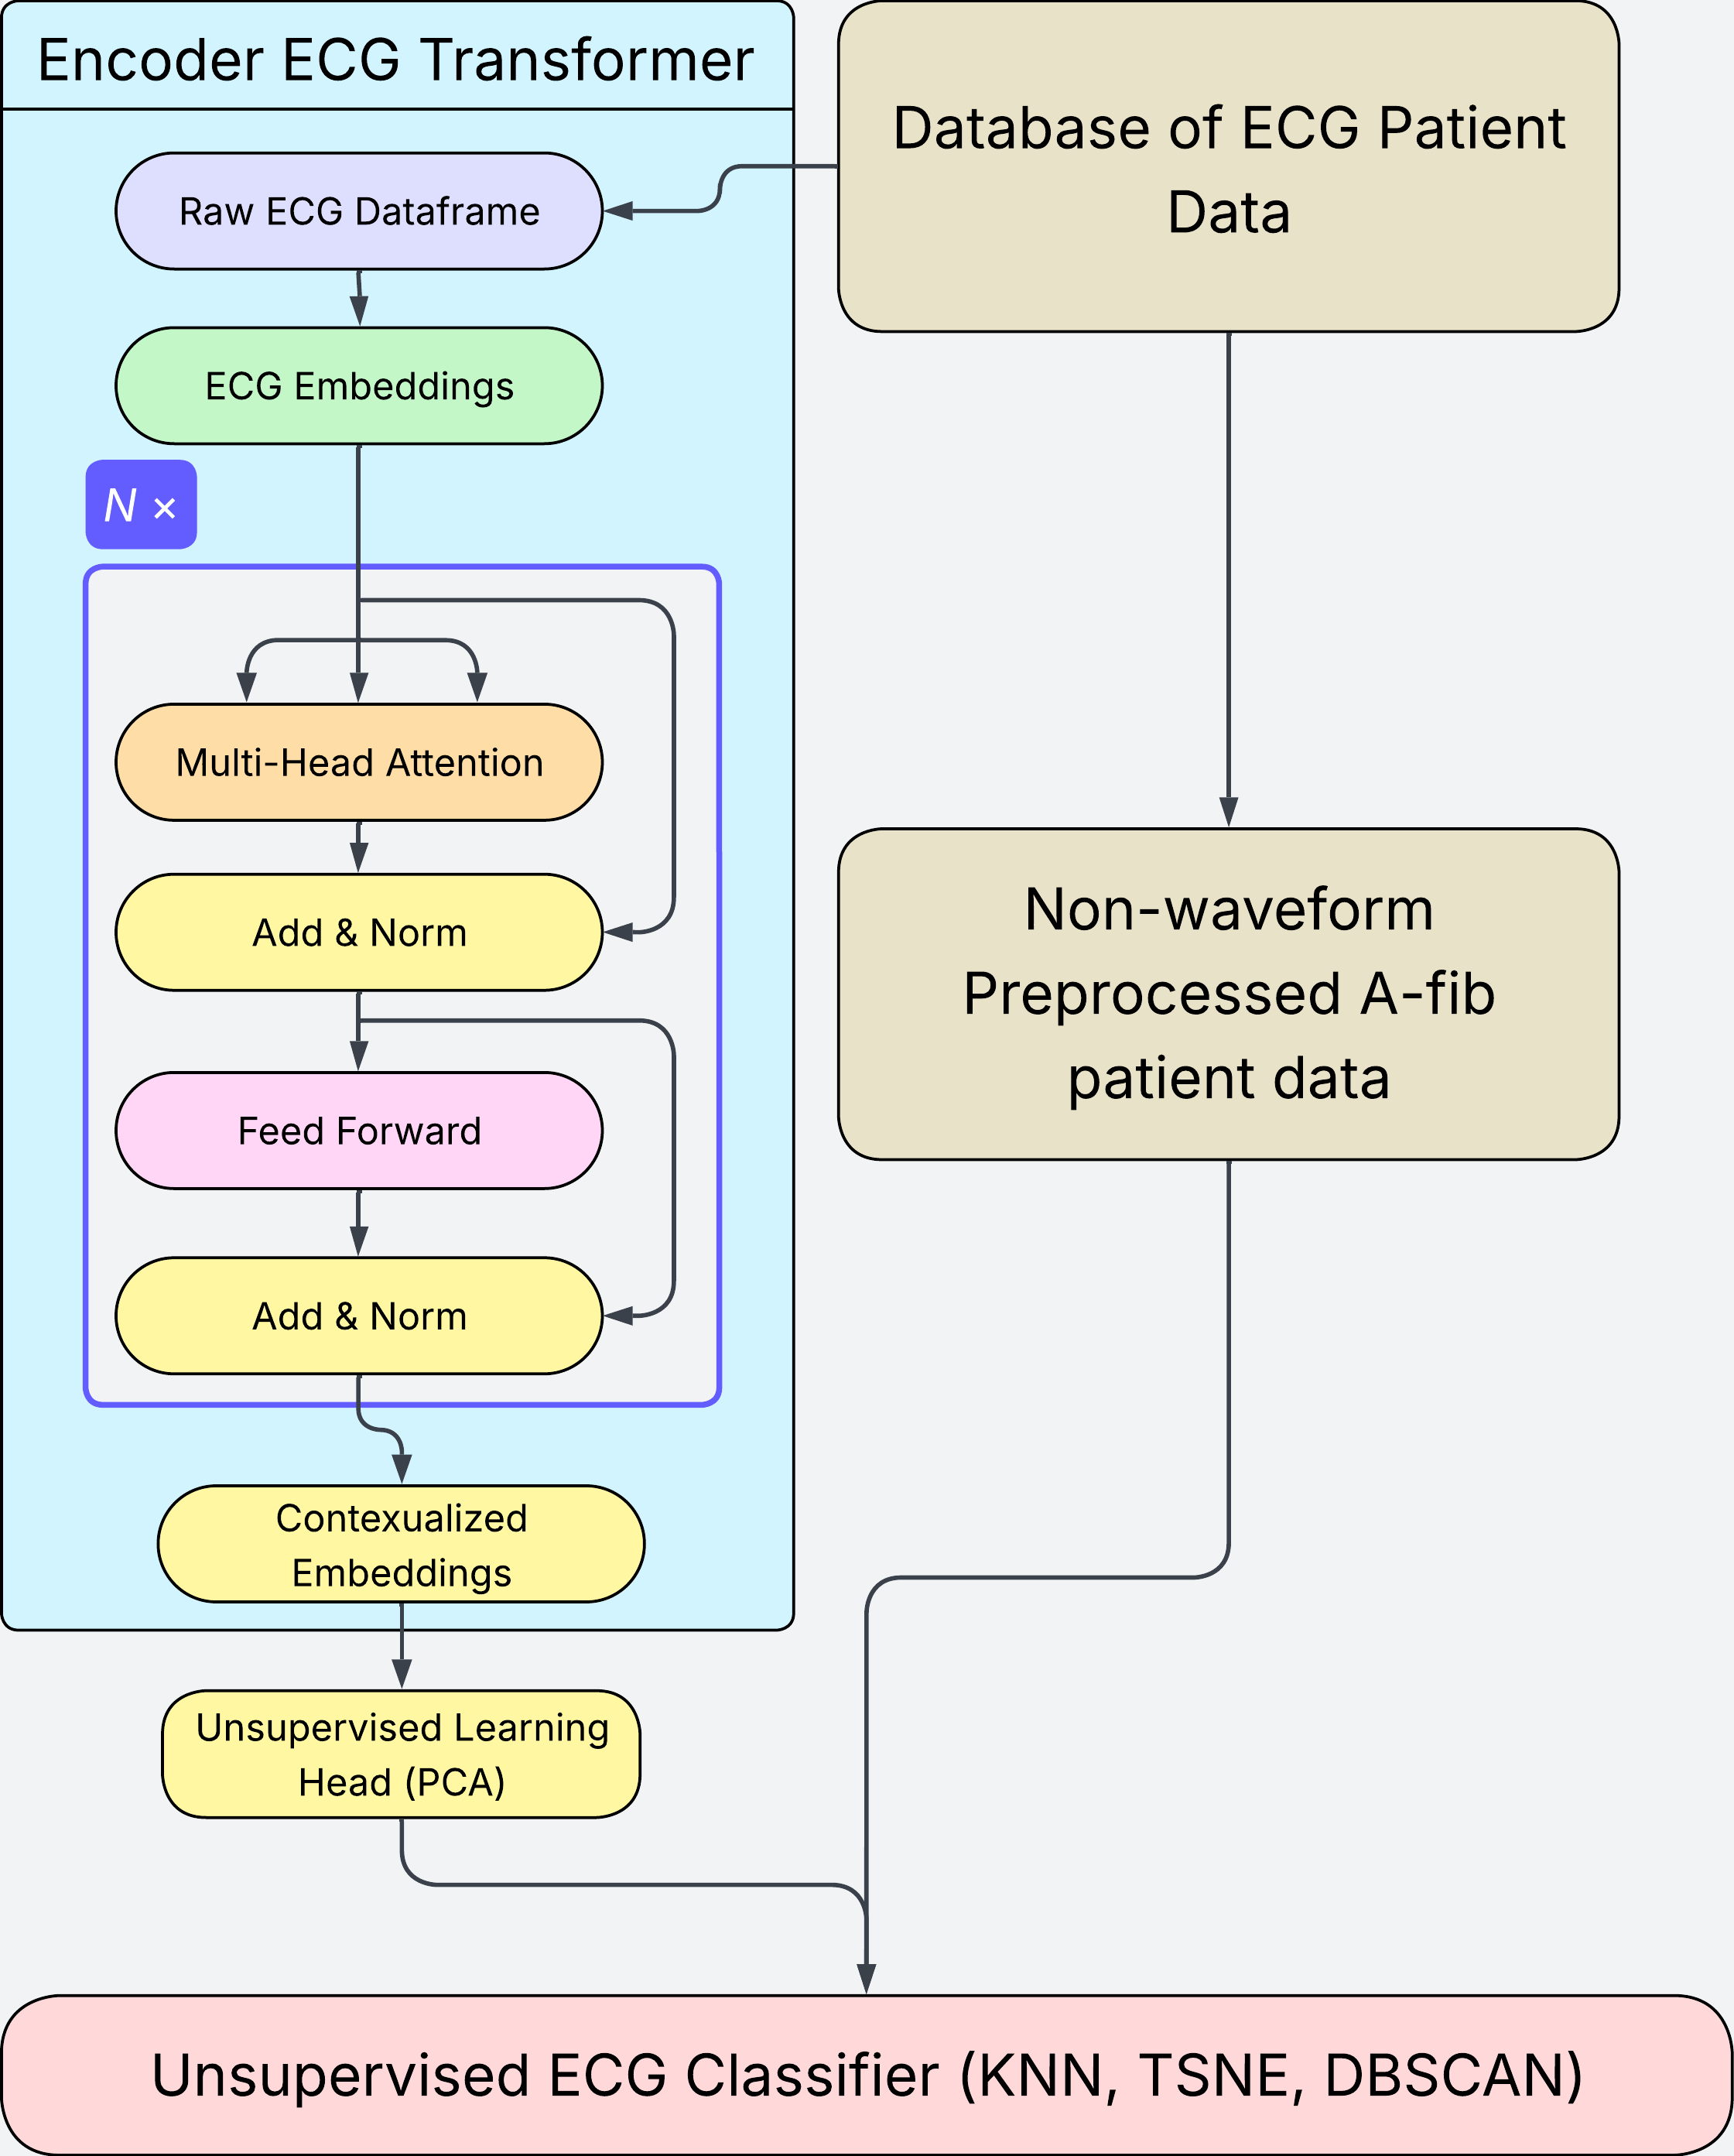
Unsupervised Learning for Atrial Fibrillation
Blake Oliaro, MD; Ajay Tripuraneni, MD
Baylor Scott and White Health
Background
Methods/Results
Atrial fibrillation (AF) is a common cardiac arrythmia characterized by an irregularly irregular ventricular rhythm in the absence of distinct, coordinated atrial activity. Patients may be classified by several criteria, including temporal definitions, structural changes, symptoms, or underlying comorbidities.
Electrocardiogram (ECG) remains the primary modality for the evaluation of cardiac arrythmias, including AF. ECGs are not only an explicit measure of voltage changes over time but also represent the implicit abstraction of a 3-Dimensional electrical field in space.
Historically, management of AF has been predicated on rate or rhythm control, however few studies have attempted to classify novel subtypes of AF. This study aims to investigate the feasibility of AF management driven by patient phenotyping using deep learning.
This study utilized MIMIC-IV, an open-source dataset from Beth Israel Deaconess Medical Center in Boston, MA. Preliminary model pipelines were tested on MIMIC-IV Clinical Database Demo and MIMIC-IV-ECG Demo.
Conclusion
This abstract introduces a framework to identify new subsets of atrial fibrillation patients by combining transformer deep learning models with unsupervised learning methods. Future work includes an analysis of clinical relevance and correlation to existing categorical etiologies of atrial fibrillation patients. We additionally intend to extend this study to examine cluster-specific outcomes, with the intent to deliver further personalized care and improved patient outcomes.
We propose the use of an Encoder-only Transformer for the learned contextualized embeddings of raw ECG data. The Transformer model was specifically chosen for its ability to implement self-attention, which is applied to each lead over time and to each time point across leads. These embeddings are then fed to an unsupervised learning model to create specific ECG clusters, which are subsequently fed to a larger clustering model that incorporates additional patient data.
Currently, the analysis of an appropriately robust model remains under active development. The experimental datasets utilized for proof-of-concept are not large enough to create useful insights.
2025 Baylor Scott & White Tech for Better Symposium
The authors have no commercial support or relevant financial interests to disclose.

