Slide 1
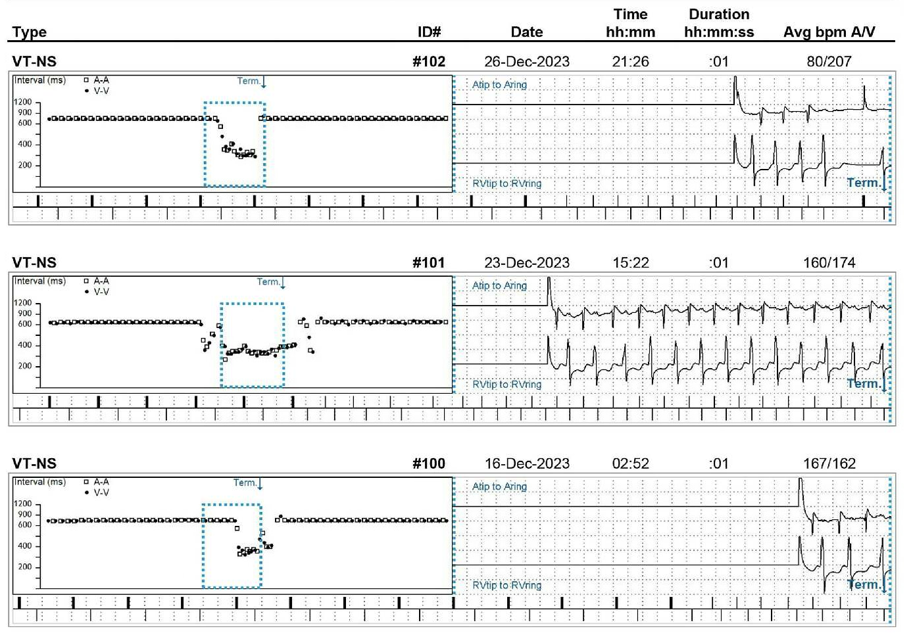
From Detection to Intervention: The Critical Role of Remote Monitoring and Wearable Devices in Patient Outcomes
Harold Averill, DO¹; Shayan-Salehi Hajivandi, MD¹; Muhammad Ahad Nabil, MD²; Shirley Reed, DO²; Peter Cheung, MD²; Javier Banchs, MD²
Internal Medicine, Baylor Scott and White Medical Center, Round Rock, TX, United States
Cardiology, Baylor Scott and White Medical Center, Round Rock, TX, United States
Disclosures
Discussion
Conclusion
The authors have no commercial support or relevant financial interests to disclose.
Photoplethysmograph: Technology enabling heart rate and rhythm detection.
Atrial Fibrillation (AF) Detection:
10.5 million U.S. adults diagnosed with AF
Increased risk for complications, including stroke.
AppleWatch clinical trial: Correctly identified AF in ~33% of participants.
Sensitivity and specificity of newer devices >93%.
Fall Detection:
Detects significant falls, vibrates, sounds alarm, contacts EMS, shares location, and notifies emergency contacts.
AF Detection
Detects irregular ventricular responses
Requires further evaluation with formal EKG for accurate diagnosis.
Detection Limitations:
Does not detect atrial activity
Threshold duration for arrhythmia detection (around 30 seconds).
Potential for detection errors, especially with brief arrhythmic episodes.
Wearable devices: Promising advancements in early detection and management of arrhythmias (e.g., AF).
Monitoring of falls, heart rhythms, and alerting emergency services is a significant healthcare leap.
Challenges:
Proper interpretation of smartwatch data is crucial.
Remote monitoring devices like pacemakers must be accurately assessed to avoid unnecessary treatments.
Future Directions:
Integration of wearable technology with clinical evaluations.
Refining smartwatches for direct atrial activity monitoring.
Potential to enhance patient outcomes and reduce healthcare burdens.
Wearable technology is transforming healthcare.
Emphasizes early intervention and proactive health management.
Collaborative approach: technology + clinical expertise for optimal patient outcomes.
Introduction
Increasing use of wearable devices like smartwatches.
Revolutionizing detection and management of cardiac arrhythmias.
Traditional diagnosis methods: in-person evaluation, formal EKG, continuous heart monitors, implantable devices.
Benefits of smartwatches: Continuous heart rate monitoring, irregular rhythm detection, alerts for potential health risks, comfortable and fashionable.
Early intervention and proactive heart health management.
Smartwatches shaping the future of cardiovascular care.
Case
Patient Profile:
79-year-old woman.
History of ectopic atrial tachycardia and sick sinus syndrome.
Dual-chamber pacemaker placement.
Initial Issue:
Routine device monitoring detected atrial arrhythmia.
Suspected atrial fibrillation (AF), leading to initiation of apixaban for stroke prevention.
Key Development:
Electrophysiologist reviewed electrograms (EGMs) → diagnosis: atrial tachycardia with episodes of 1:1 SVT (not AF).
Discontinuation of anticoagulation therapy.
Fall Event:
Two months later, patient fell at home.
Smartwatch detected fall and activated fall detection.
Automatically shared location with emergency contacts and EMS.
Outcome:
EMS transported patient to the Emergency Department (ED).
Sustained a forehead laceration, CT imaging unremarkable.
Received sutures and discharged without complications.
Fortunately, not on anticoagulation
References
Perez MV, Mahaffey KW, Hedlin H, et al. Large-Scale Assessment of a Smartwatch to Identify Atrial Fibrillation. N Engl J Med. 2019 Nov 14;381(20):1909-1917. doi: 10.1056/NEJMoa1901183. PMID: 31722151; PMCID: PMC8112605.
Dörr M, Nohturfft V, Brasier N, et al. The WATCH AF Trial: SmartWATCHes for Detection of Atrial Fibrillation. JACC Clin Electrophysiol. 2019 Feb;5(2):199-208. doi: 10.1016/j.jacep.2018.10.006. Epub 2018 Nov 28. PMID: 30784691.
T Noubiap JJ, Tang JJ, Teraoka JT, et al. Minimum National Prevalence of Diagnosed Atrial Fibrillation Inferred From California Acute Care Facilities. J Am Coll Cardiol. 2024 Oct 15;84(16):1501-1508. doi:10.1016/j.jacc.2024.07.014. Epub 2024 Sep 11. PMID: 39269390.
Figure 1: Intracardiac tracings showing 1:1 SVT episodes as opposed to atrial fibrillation
2025 Baylor Scott & White Tech for Better Symposium

