Slide 1
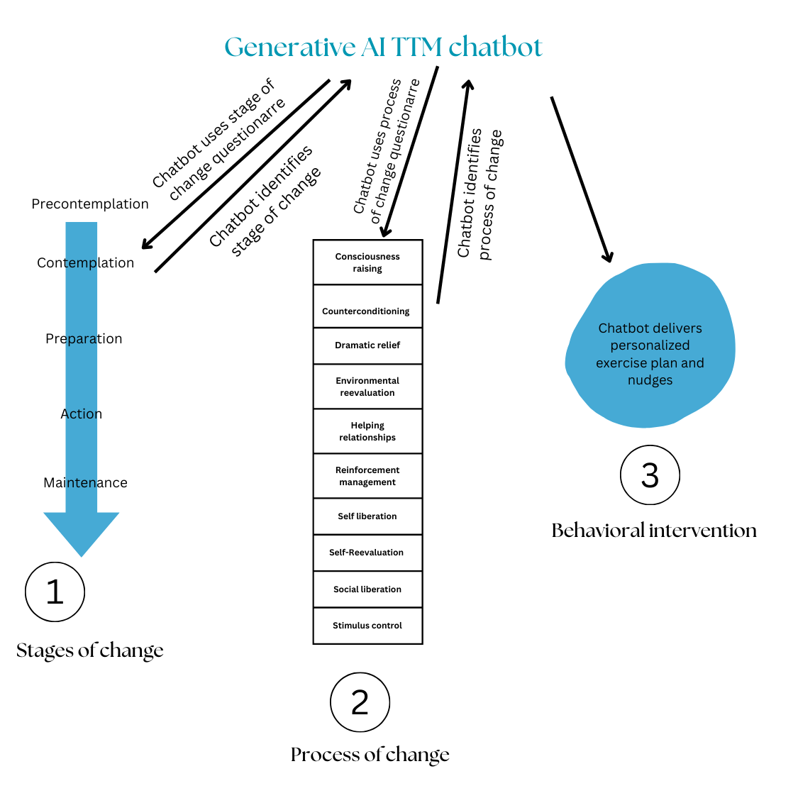
Designing a Generative AI-Supported Behavioral Intervention Model to Enhance Physical Activity in Teens
Chaitra Surapaneni, Isha Tripuraneni, Samer Salman, Srividya Venigalla MD, Sainyam Galhotra MD
Background
The childhood obesity rate in Texas is currently 21.5% (ages 10-17) which is one of the highest in the nation (1).
Childhood obesity rates are 1.5 times higher in children experiencing recurrent poverty when compared to who never experienced poverty (2). This relates to the fact that areas with poverty have a lower rate of childhood exercise and physical activity (3).
Children who were obese had increased risks of type 2 diabetes, hypertension, dyslipidemia, and carotid-artery atherosclerosis.
The overweight and obese children who became non obese as adults had outcomes of risks that were similar to those among adults who were never obese as kids (4).
Methods
Review
We reviewed published literature on behavior interventions based on the Transtheoretical Model (TTM) to enhance physical activity, with a particular focus on children.
Develop
Using these insights, we developed a behavioral chatbot using Generative Artificial Intelligence (GAI) designed for use by physical education (PE) teachers.
Implement
Since PE classes are often mandatory for students who do not participate in sports and may not be getting sufficient exercise, this chatbot may serve as a valuable tool to the high-risk children.
Results
The literature review revealed limited data on interventions for change along the TTM in children (6,7).
Multiple studies in adults using the TTM model that have been shown to be effective in improving physical activity (8). Recent studies support large language models and GAI's ability to enhance behavioral interventions to improve lifestyle changes (9,10,11)
Using the data above we designed a GAI chatbot to implement a questionnaire that identifies the student’s phase of change and process of change along the TTM and subsequently provides them with behavioral ‘teen nudges’ to promote movement along the TTM (figure 1).
This GAI chat bot will be able to increase teen engagement in exercise by providing personalized, behavioral TTM nudges using conversational AI, gamification, and contemporary references to reduce barriers, maintain motivation, and promote long-term behavioral change.
Conclusions : A behavioral chatbot-based lifestyle program could be a convenient intervention for PE teachers working in underserved neighborhoods to administer individualized intervention plans to their students to improve exercise who might not have resources outside of school.
Limitations : Formal clinical validation of this chatbot is planned to evaluate its real-world effectiveness. Funding and conflicts: None.
Study Question/Hypothesis: Designing a Generative AI-Supported Behavioral Intervention Model to Enhance Physical Activity in At-risk Teens

