Slide 1
Community Education – Learning Group

Slide 2
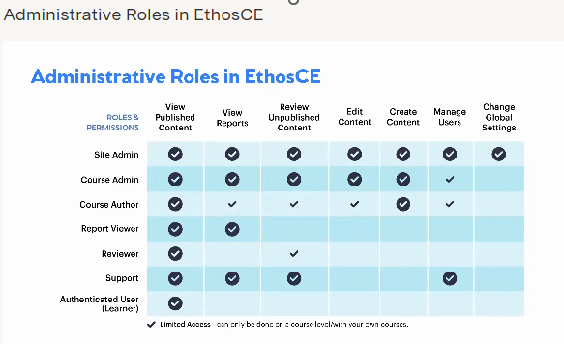

Slide 3
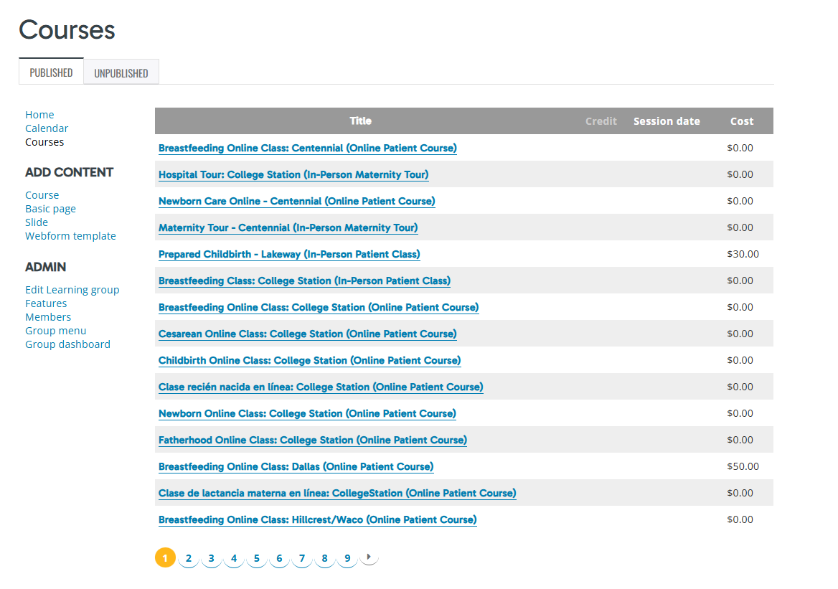
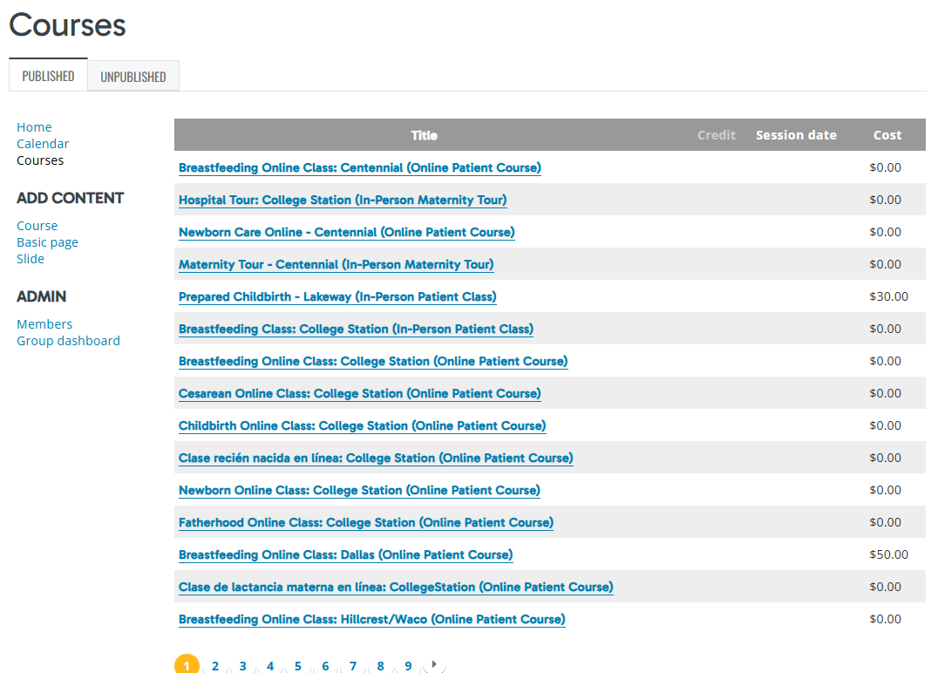
Site Admin VS Learning Group Administrative Member
Can a search field be added here?

Slide 4
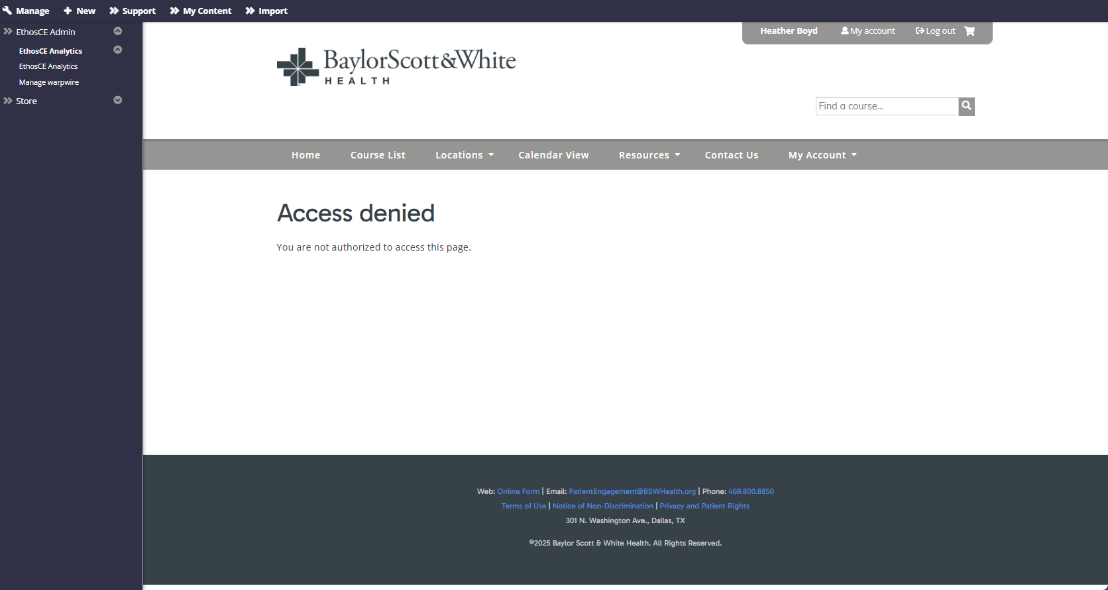
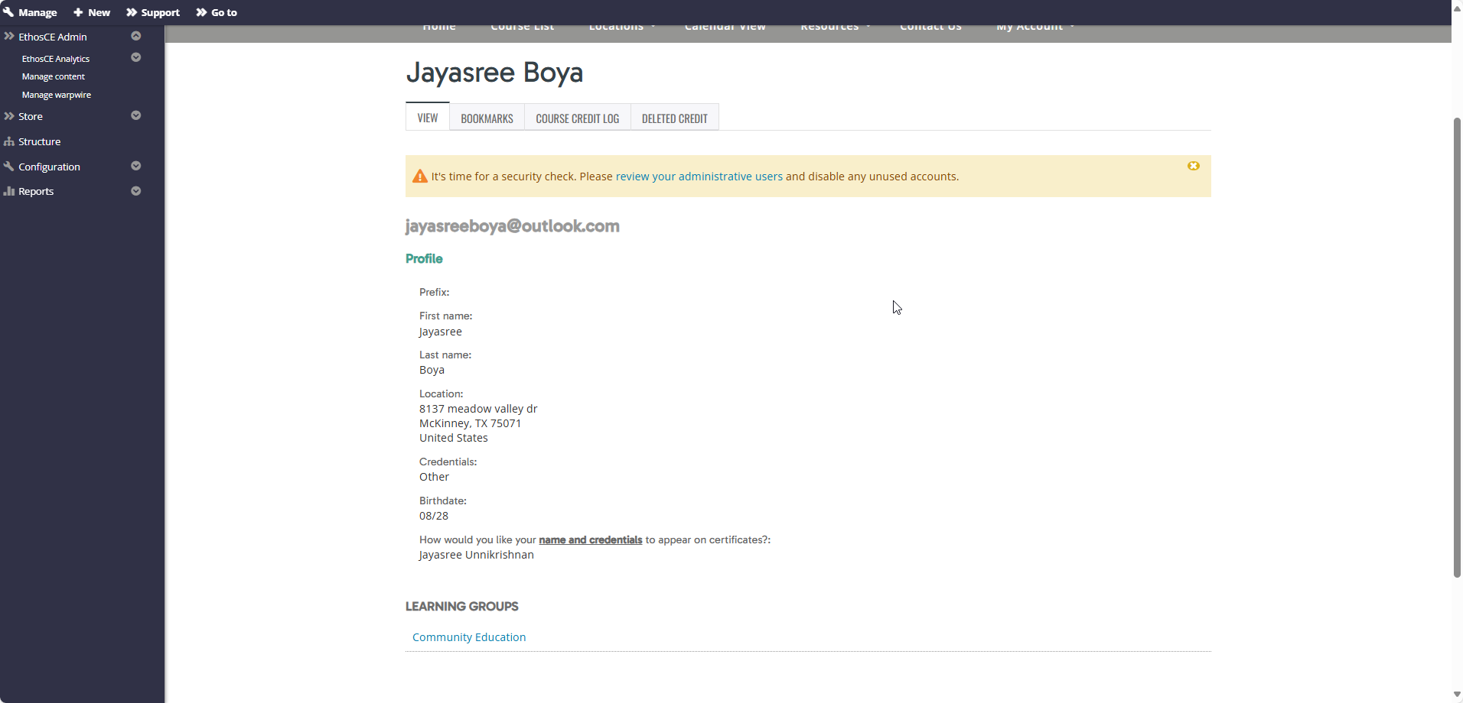
Course Author Vs Course Admin – Manage Users
Course admin is able to see/view profile information – ONLY within a learning group.

Slide 5
Role | Manage Users | Manage Content | Orders | Roles | Webforms
Course Admin | Yes – but unable to search for users OUTSIDE of LG | Yes – Can view ALL content within EthosCE | Can view orders – but not the actual receipt | No | Yes
Course Author | No | No |  | No | No
Support | Yes – ALL (Can not merge) | Yes - ALL | Yes | No | No
Site Admin | Yes – ALL | Yes | Yes - ALL | Yes | Yes
Custom Role?
Manage Users | Manage Content | Orders | Roles | Webforms
Yes – Only within their assigned LG | Yes – Only within their assigned LG | Yes – VIEW ONLY RIGHTS | NO | Yes – within assigned LG ONLY

